Slide 1

Magaling mag-Kwento ang PINOY
Notes:
NO CAM

Slide 2



SHARE THE BLESSINGS OF GOOD HEALTH
Notes:
NO CAM

Slide 3


We Invite You To Join Our Business
Notes:
TOP RIGHT

Slide 4


We Invite You To Join
Our Business
HOW CAN YOU START?
Simply Use Our Products
Notes:
TOP RIGHT

Slide 5

We Invite You To Join
Our Business
Simply Use Our Products
P6,980
Notes:
TOP RIGHT

Slide 6


How To Join?
PURCHASE A SET OF PRODUCTS
SMH BUSINESS PACKAGE
INCLUSIONS:
PRODUCTS FROM THE CHOSEN PACKAGE
LIFETIME SMH DISTRIBUTOR
DISCOUNT PRIVILEGES
P6,980
50%
DISCOUNT
Notes:
NO CAM

Slide 7
How To Join?
PURCHASE A SET OF PRODUCTS
SMH BUSINESS PACKAGE
INCLUSIONS:
PRODUCTS FROM THE CHOSEN PACKAGE
LIFETIME SMH DISTRIBUTOR
DISCOUNT PRIVILEGES
24/7 ONLINE WEB PORTAL
Notes:
NO CAM

Slide 8
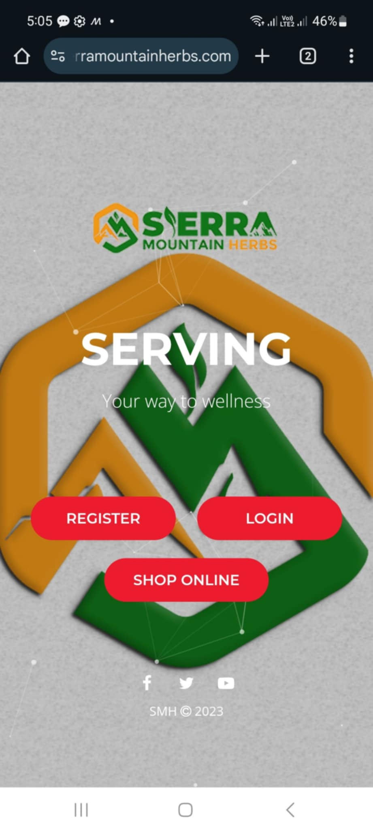

How To Join?
PURCHASE A SET OF PRODUCTS
SMH BUSINESS PACKAGE
INCLUSIONS:
PRODUCTS FROM THE CHOSEN PACKAGE
LIFETIME SMH DISTRIBUTOR
DISCOUNT PRIVILEGES
24/7 ONLINE WEB PORTAL
PROMOTE &
ADVERTISE ONLINE
Notes:
NO CAM

Slide 9
LANDING PAGES
Notes:
TOP RIGHT

Slide 10



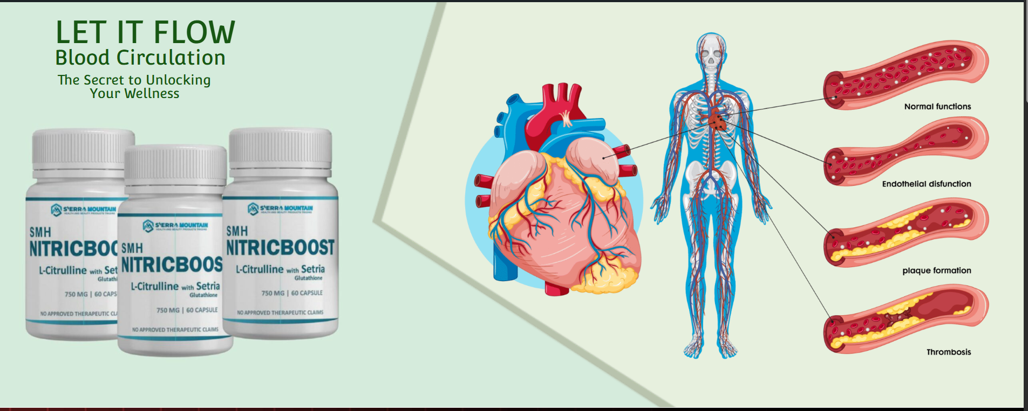


LANDING PAGES
Notes:
TOP RIGHT

Slide 11
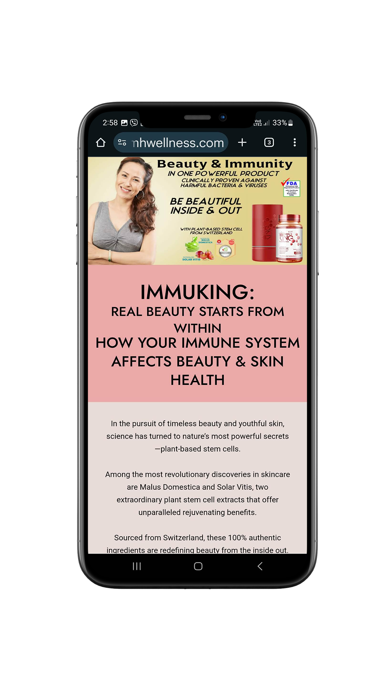
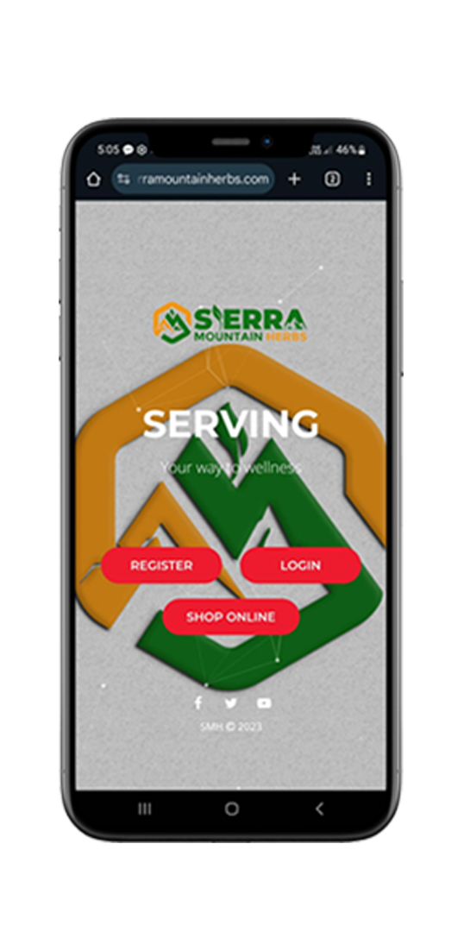
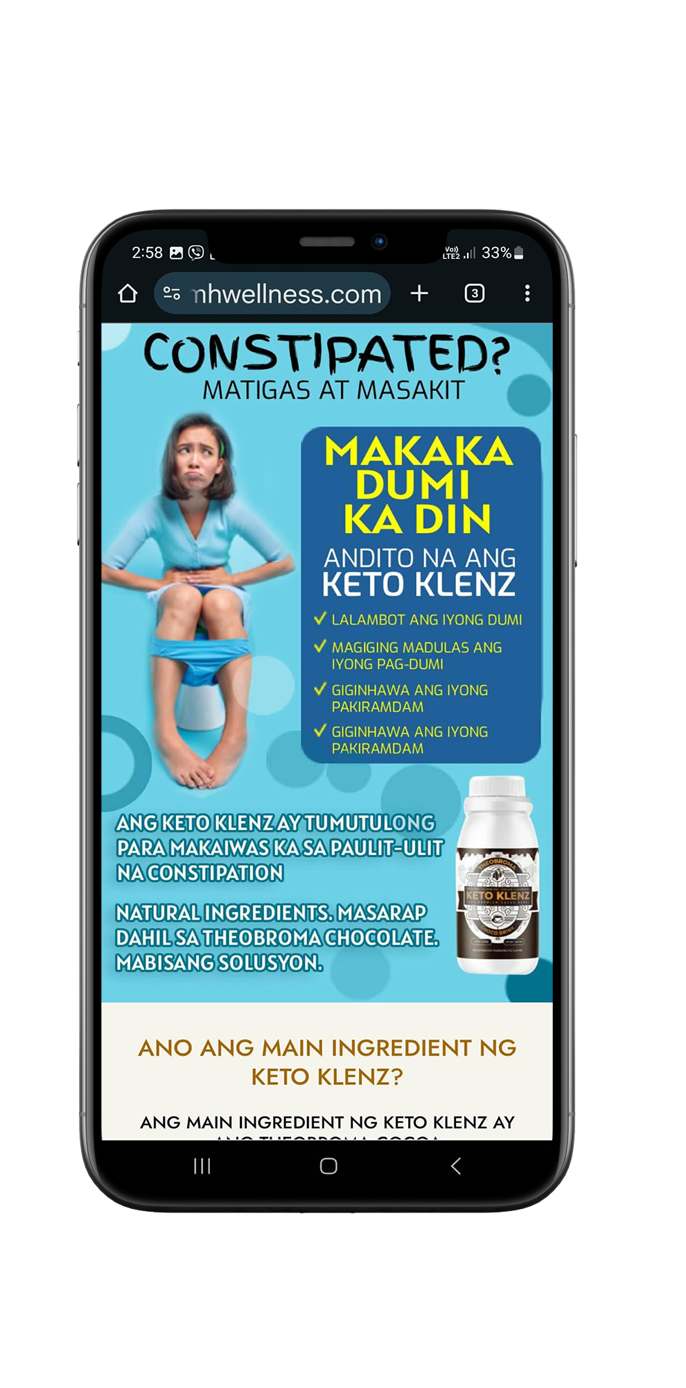
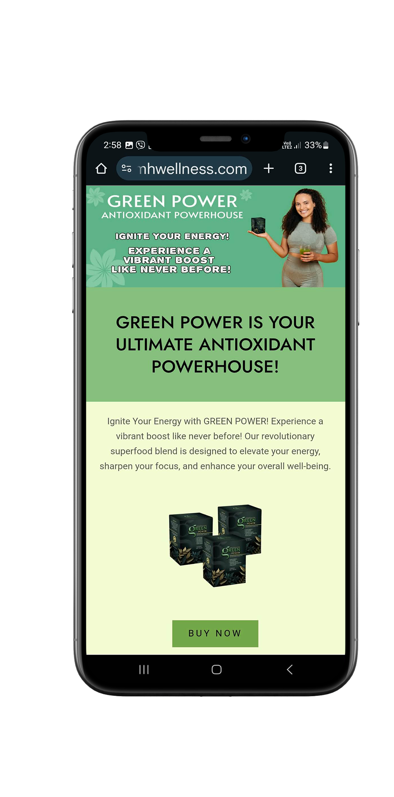
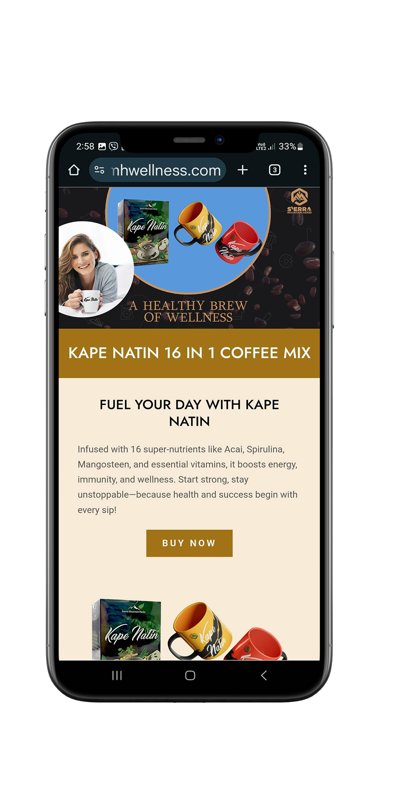
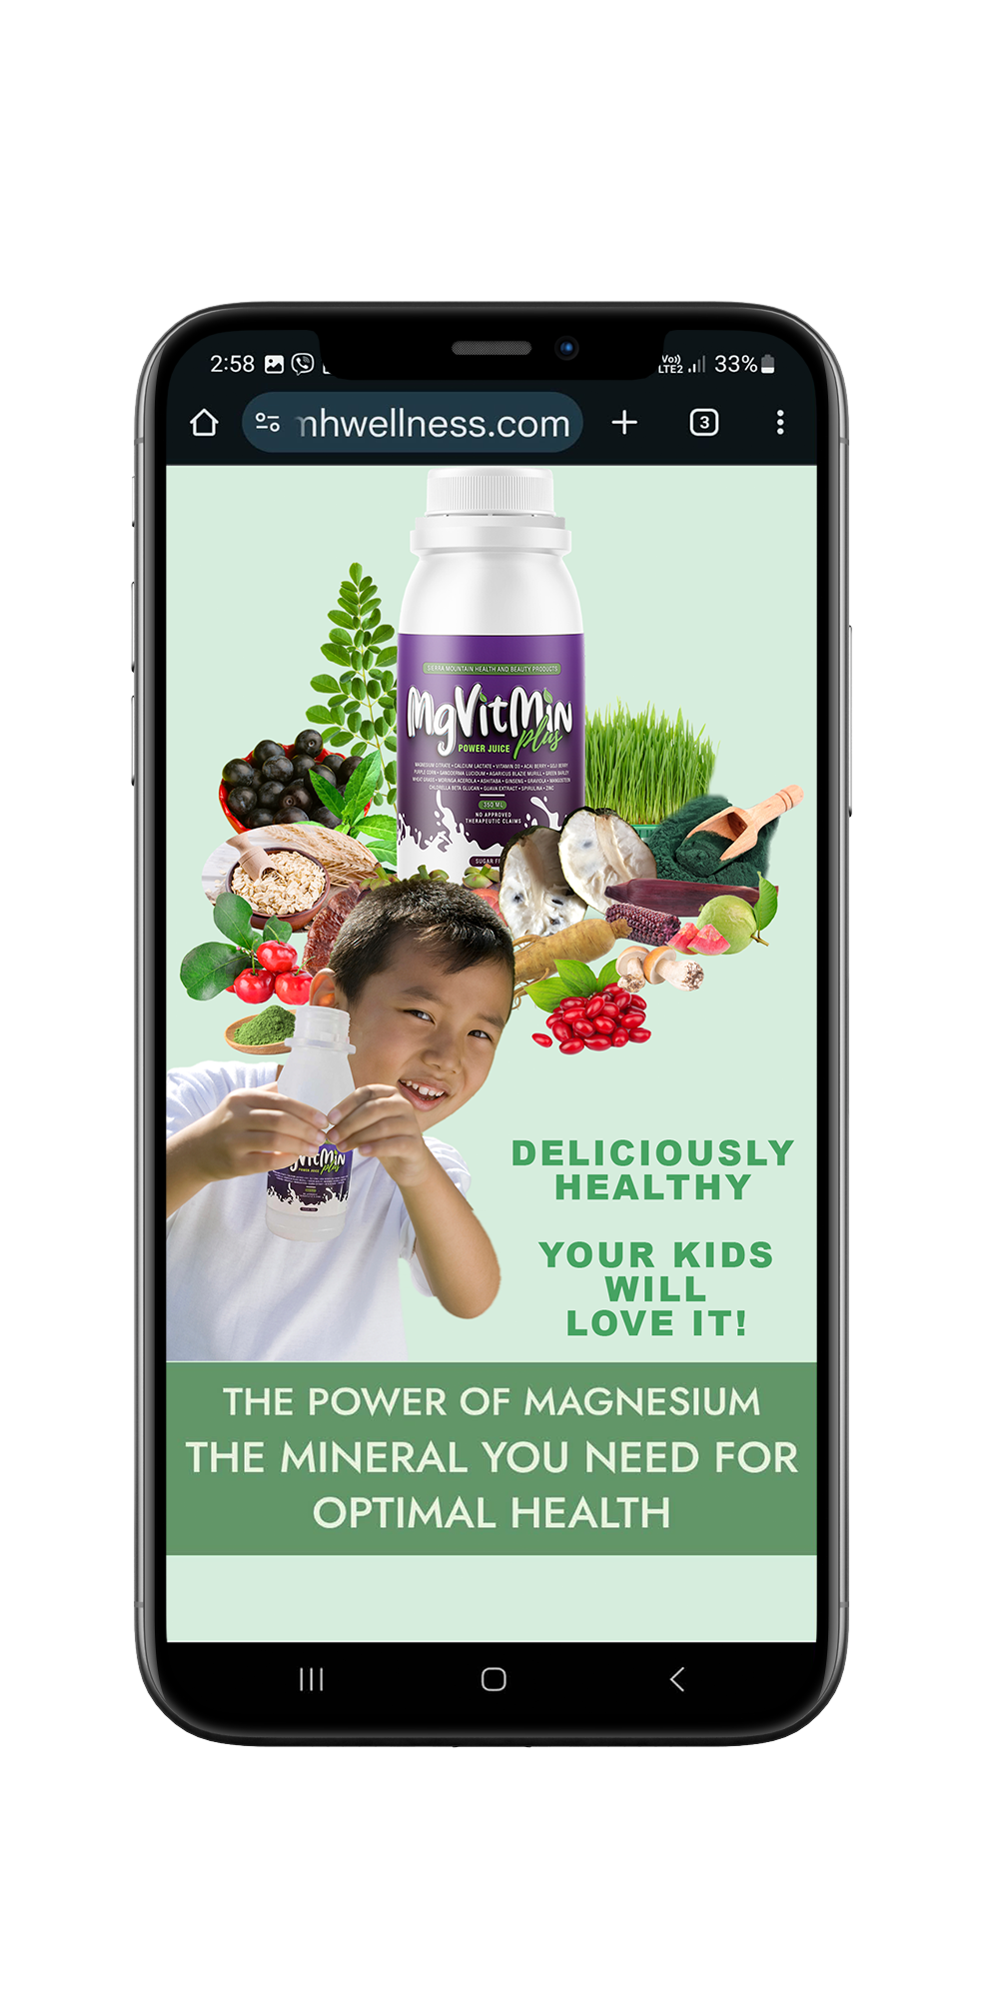
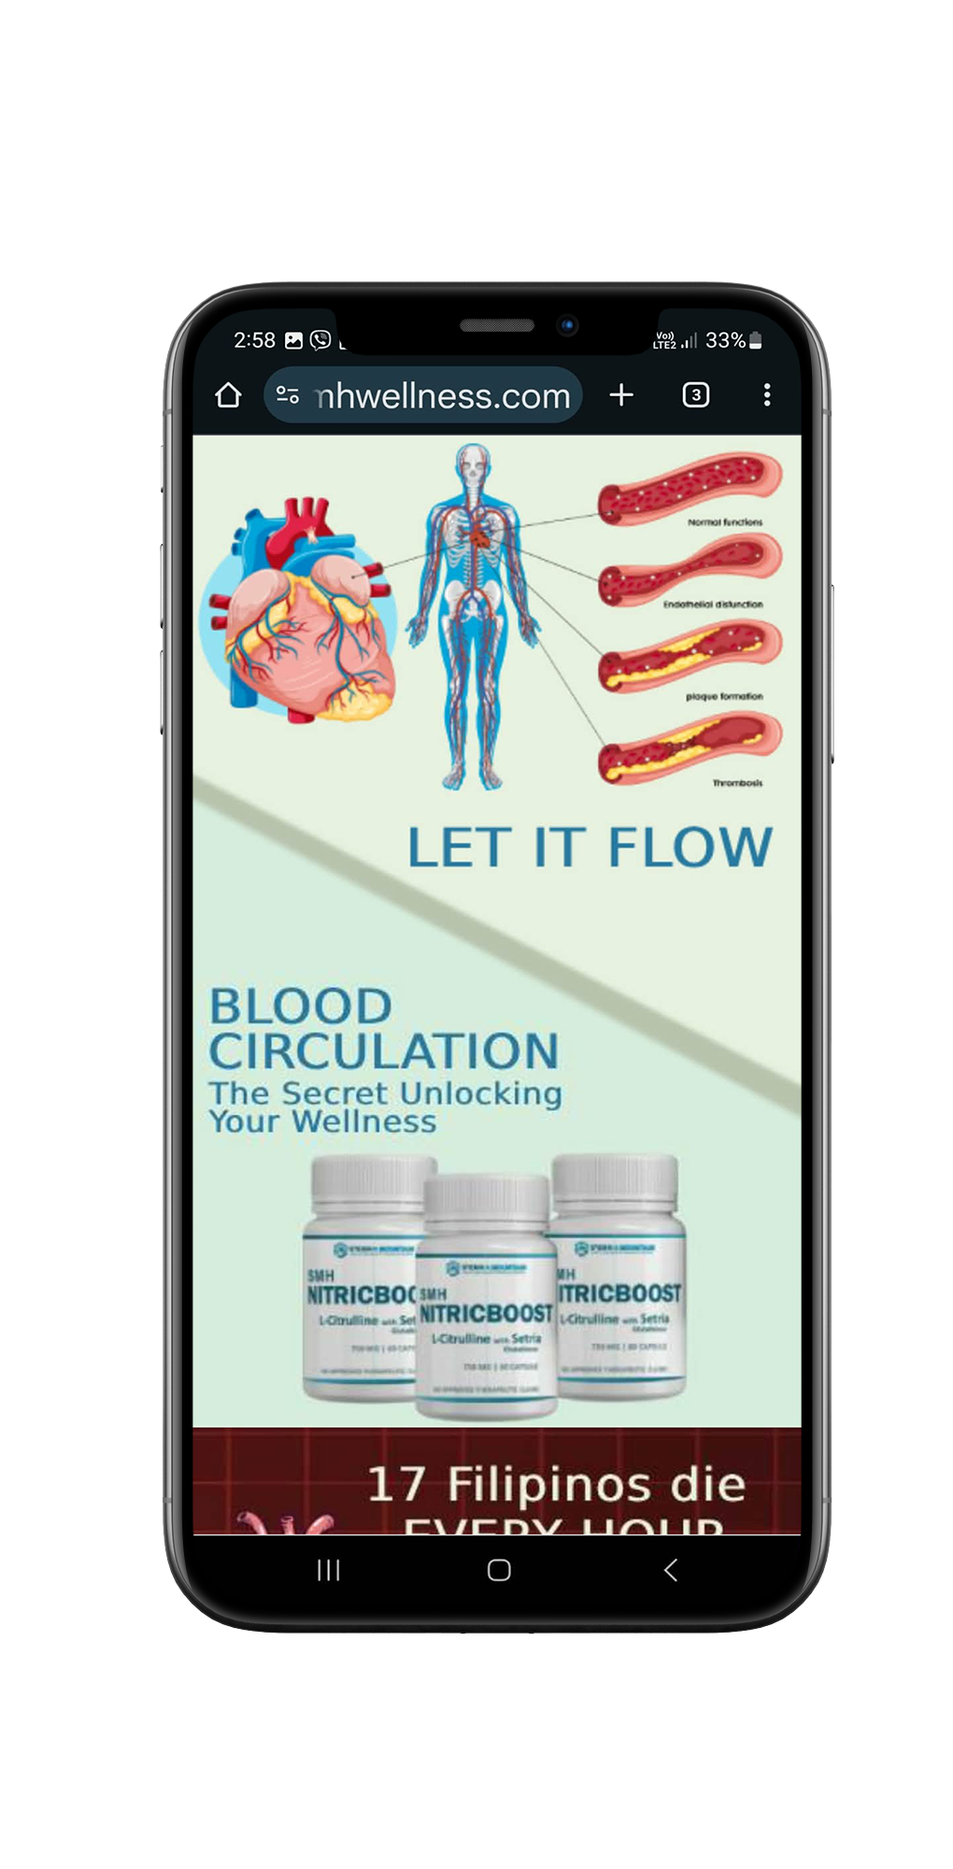

LANDING PAGES
Notes:
TOP RIGHT

Slide 12

SMH ONLINE SYSTEM
Notes:
TOP RIGHT

Slide 13
SMH ONLINE SYSTEM
AFFILIATE
LINK
Notes:
TOP RIGHT

Slide 14

SMH ONLINE SYSTEM
AFFILIATE
LINK
Notes:
TOP RIGHT

Slide 15
SMH ONLINE SYSTEM
E-COMMERCE
AFFILIATE
LINK
Notes:
TOP RIGHT

Slide 16
SMH ONLINE SYSTEM
AFFILIATE
E-COMMERCE
LINK
Notes:
TOP RIGHT

Slide 17

SMH ONLINE SYSTEM
AFFILIATE
E-COMMERCE
LINK
Notes:
TOP RIGHT

Slide 18
SMH ONLINE SYSTEM
DROPSHIPPING
AFFILIATE
E-COMMERCE
LINK
Notes:
TOP RIGHT

Slide 19
SMH ONLINE SYSTEM
AFFILIATE
DROP
E-COMMERCE
LINK
SHIPPING
Notes:
TOP RIGHT

Slide 20

SMH ONLINE SYSTEM
WITH PRODUCTS
P6,980
Notes:
TOP RIGHT

Slide 21
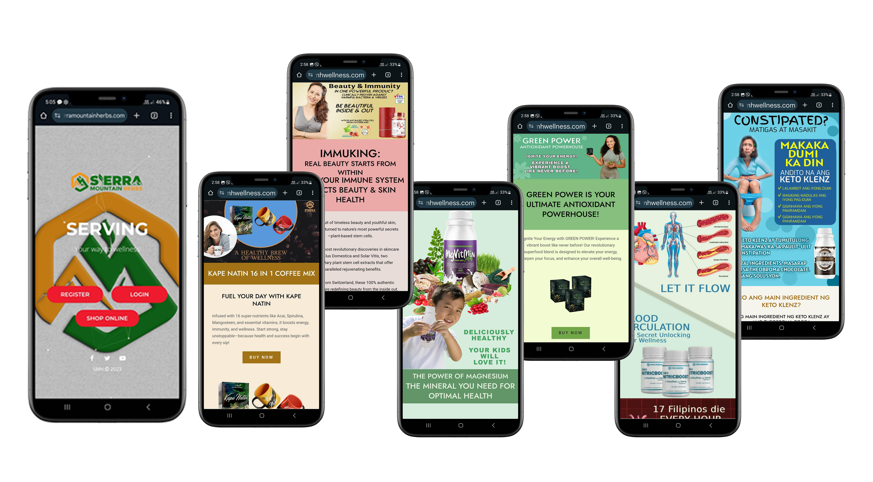
SMH ONLINE SYSTEM
WITH PRODUCTS
P6,980
Notes:
TOP RIGHT

Slide 22

SMH ONLINE SYSTEM
WITH PRODUCTS
P6,980
Notes:
TOP RIGHT

Slide 23

SMH ONLINE SYSTEM
WITH PRODUCTS
P6,980
Notes:
TOP RIGHT

Slide 24
How To Join?
PURCHASE A SET OF PRODUCTS
SMH BUSINESS PACKAGE
INCLUSIONS:
PRODUCTS FROM THE CHOSEN PACKAGE
LIFETIME SMH DISTRIBUTOR
DISCOUNT PRIVILEGES
24/7 ONLINE WEB PORTAL
ACCESS TO FREE
TRAININGS
EVERY
FRIDAY 4PM
Notes:
TOP RIGHT

Slide 25



Notes:
TOP RIGHT

Slide 26
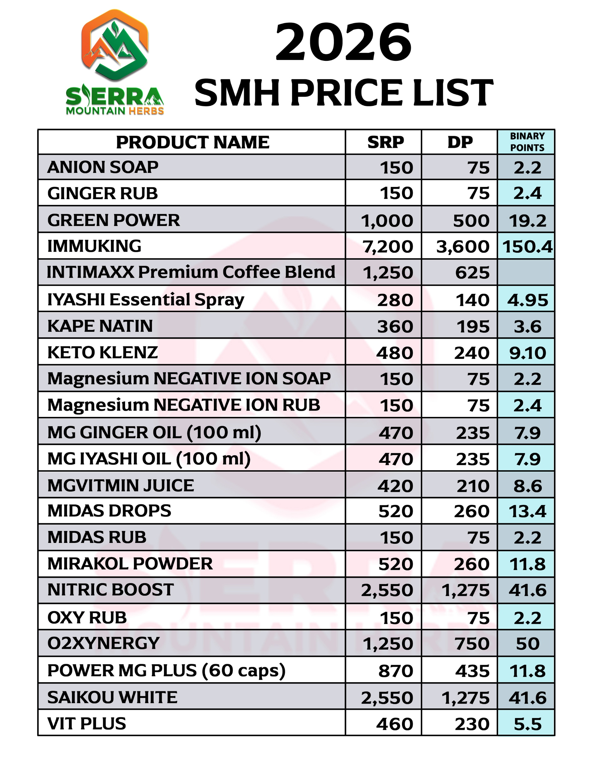
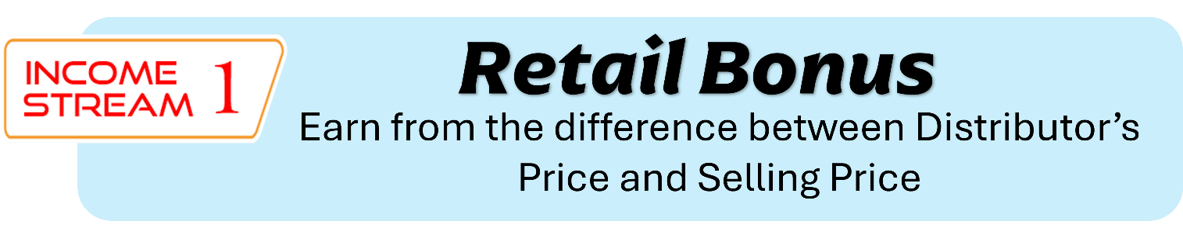

Notes:
TOP RIGHT

Slide 27






P240
P210
P480
P420
P75
P195
P3,600
P150
P360
P7,200
Notes:
TOP RIGHT

Slide 28



Direct Referral Bonus
Earn Direct Referral Bonus every time someone purchased STAR PROSELLER Package
DIRECTLY FROM YOU
P6,980.00
DRB
P500.00
Notes:
!! Unitree

Slide 29





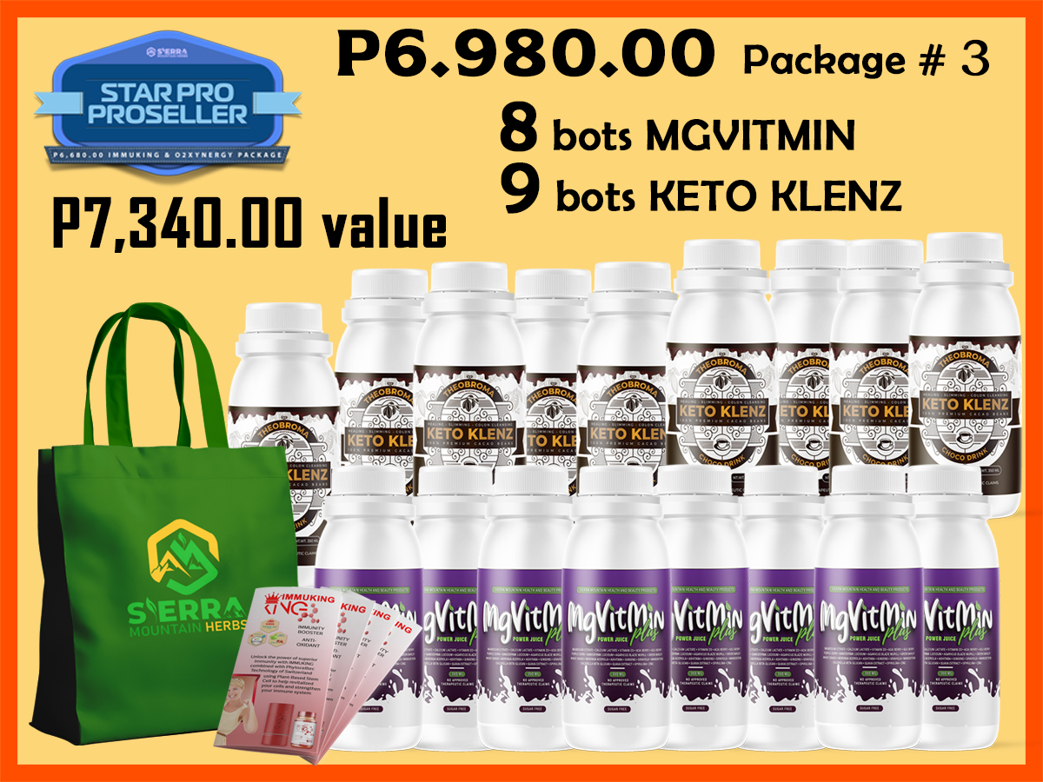
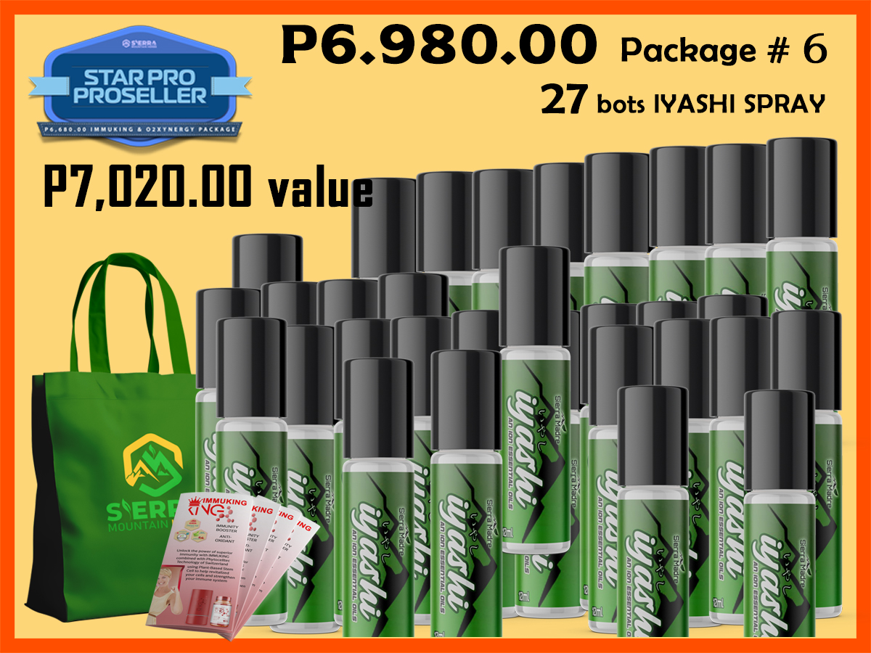
Direct Referral Bonus
Earn Direct Referral Bonus every time someone purchased STAR PROSELLER Package DIRECTLY FROM YOU
P500
P500
P500
YOU CAN
SPONSOR
AS MANY
PEOPLE
AS YOU CAN

Slide 30
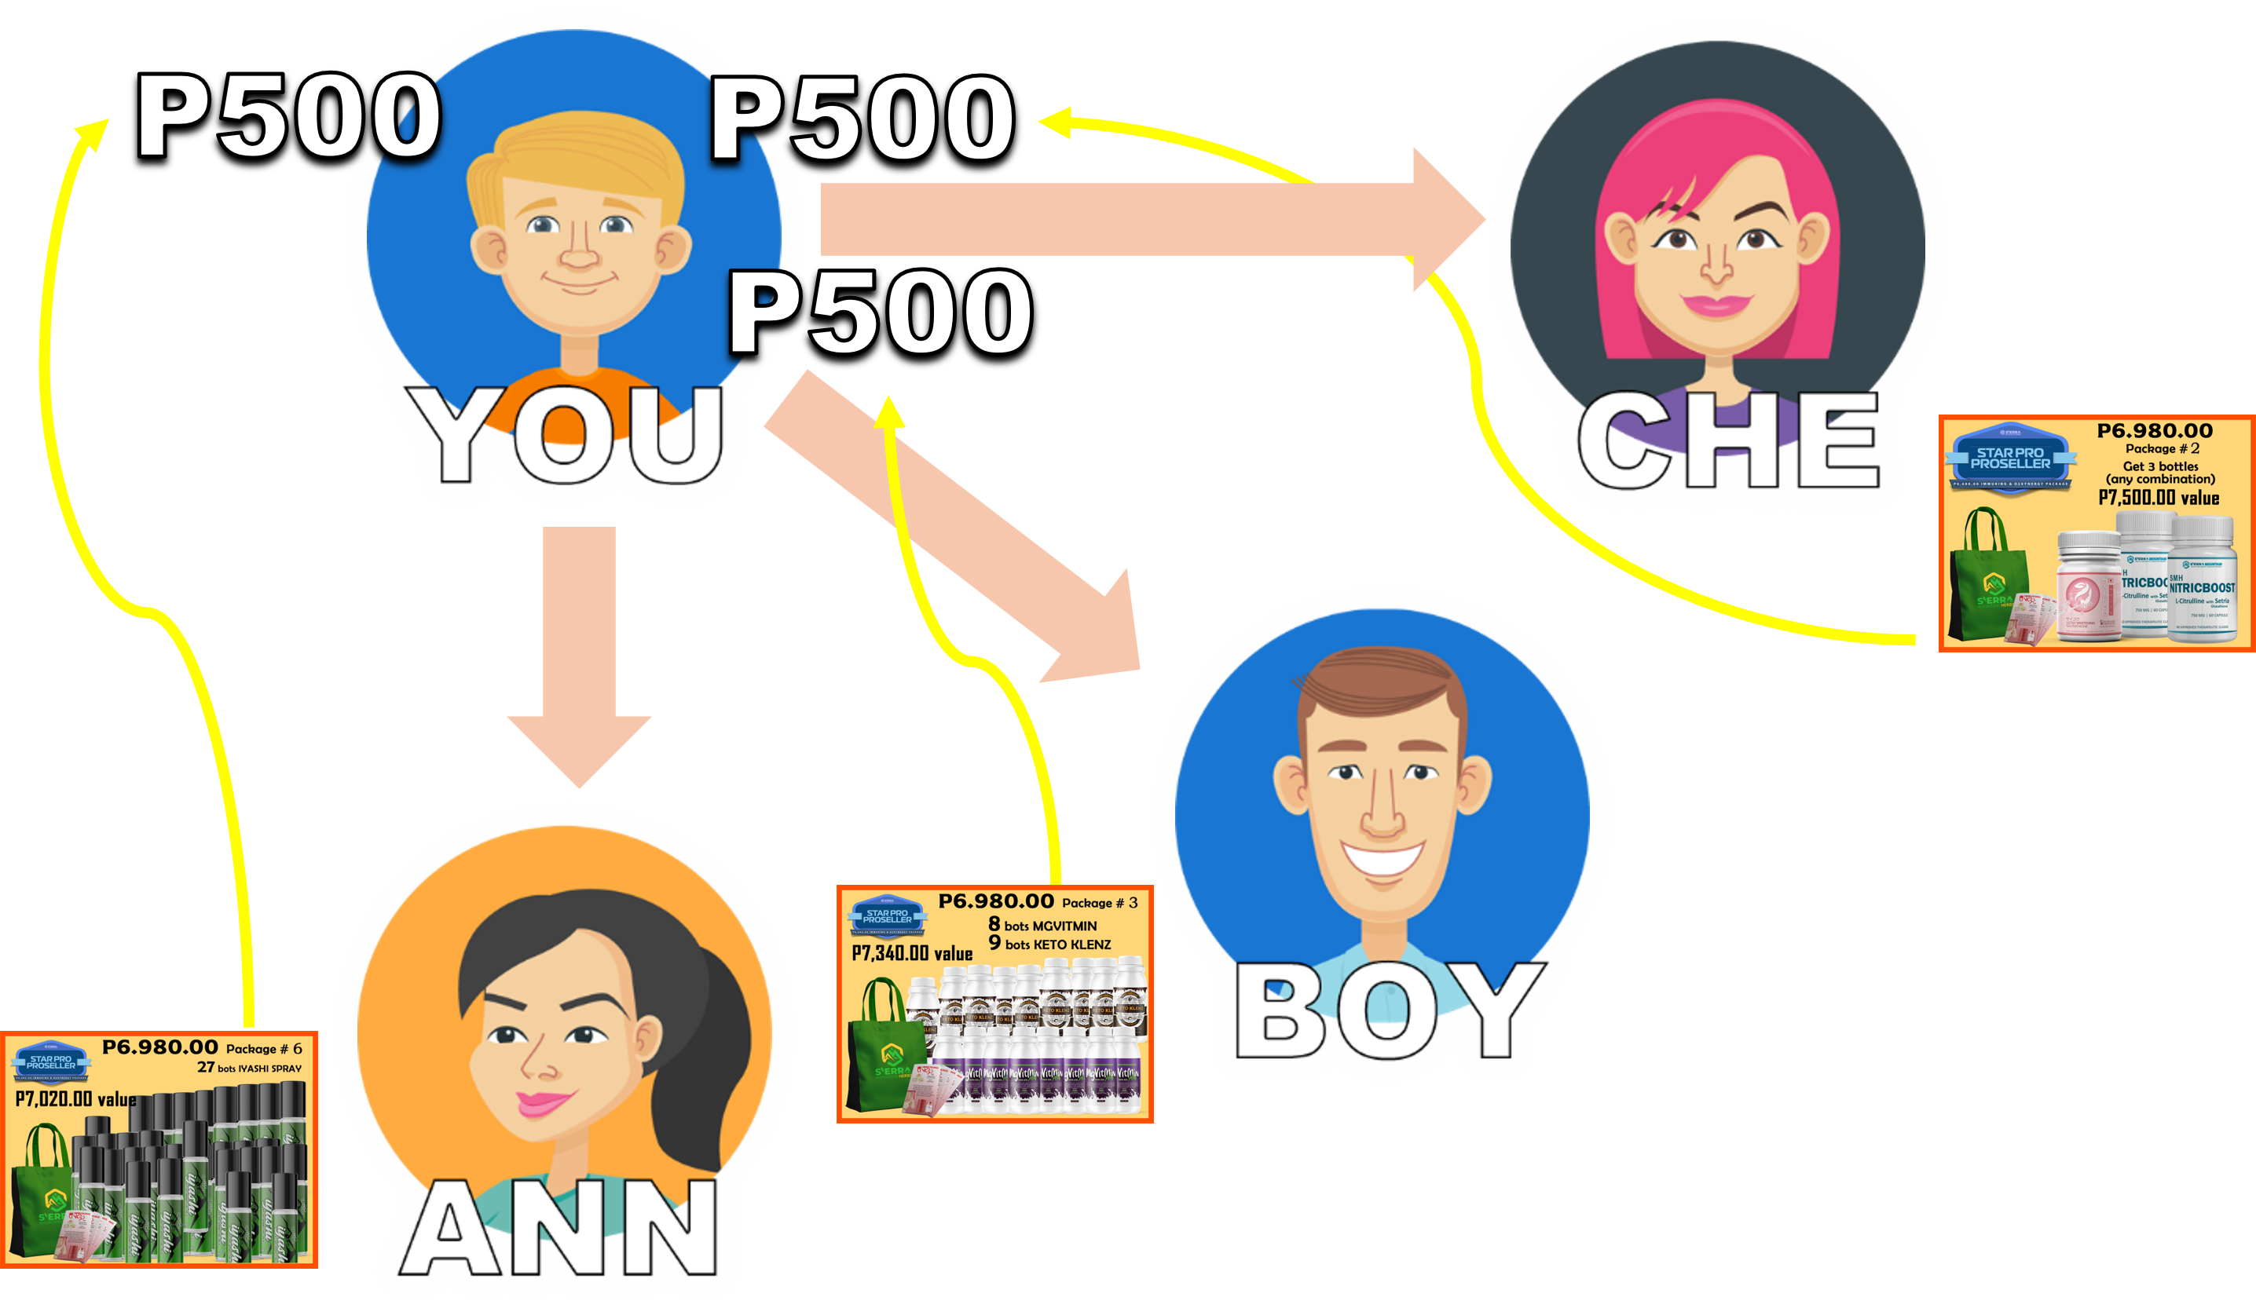
Direct Referral Bonus
Earn Direct Referral Bonus every time someone purchased STAR PROSELLER Package DIRECTLY FROM YOU
YOU CAN
SPONSOR
AS MANY
PEOPLE
AS YOU CAN

Slide 31


Direct Referral Bonus
Earn Direct Referral Bonus every time someone purchased STAR PROSELLER Package DIRECTLY FROM YOU
OPTION
YOU CAN
SPONSOR
AS MANY
PEOPLE
AS YOU CAN
CONVERT P500.00
DIRECT REFERRAL
TO 2 BOXES
GREEN POWER
P2,000.00

Slide 32
Team Sales Bonus
Notes:
TOP RIGHT

Slide 33


Team Sales Bonus
TO EARN TEAM SALES BONUS,
YOU NEED TO DEVELOP A
MINIMUM OF TWO SALES GROUP
Notes:
TOP RIGHT

Slide 34

Team Sales Bonus
TO EARN TEAM SALES BONUS,
YOU NEED TO DEVELOP A
MINIMUM OF TWO SALES GROUP
UP TO A MAXIMUM OF THREE SALES GROUP
Notes:
TOP RIGHT

Slide 35
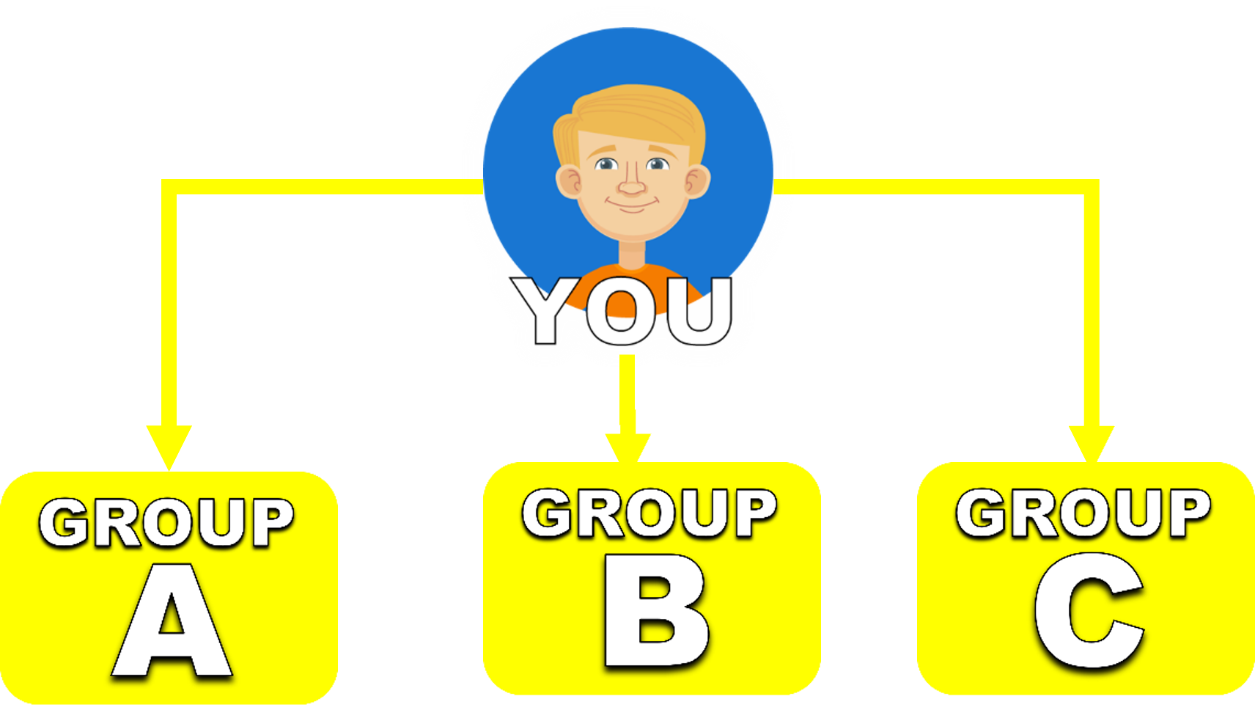
Team Sales Bonus
TO EARN TEAM SALES BONUS,
YOU NEED TO DEVELOP A
MINIMUM OF TWO SALES GROUP
UP TO A MAXIMUM OF THREE SALES GROUP
Notes:
TOP RIGHT

Slide 36
Team Sales Bonus
TO EARN TEAM SALES BONUS,
YOU NEED TO DEVELOP A
MINIMUM OF TWO SALES GROUP
UP TO A MAXIMUM OF THREE SALES GROUP
Team Sales Bonus
is the income
YOU EARN FROM THE
PRODUCT PACKAGES
Notes:
TOP RIGHT

Slide 37
Team Sales Bonus
TO EARN TEAM SALES BONUS,
YOU NEED TO DEVELOP A
MINIMUM OF TWO SALES GROUP
UP TO A MAXIMUM OF THREE SALES GROUP
Team Sales Bonus
is paid based on
POINTS
Notes:
TOP RIGHT

Slide 38
Team Sales Bonus
TO EARN TEAM SALES BONUS,
YOU NEED TO DEVELOP A
MINIMUM OF TWO SALES GROUP
UP TO A MAXIMUM OF THREE SALES GROUP
Every Product Package
has a corresponding
POINTS
Notes:
TOP RIGHT

Slide 39
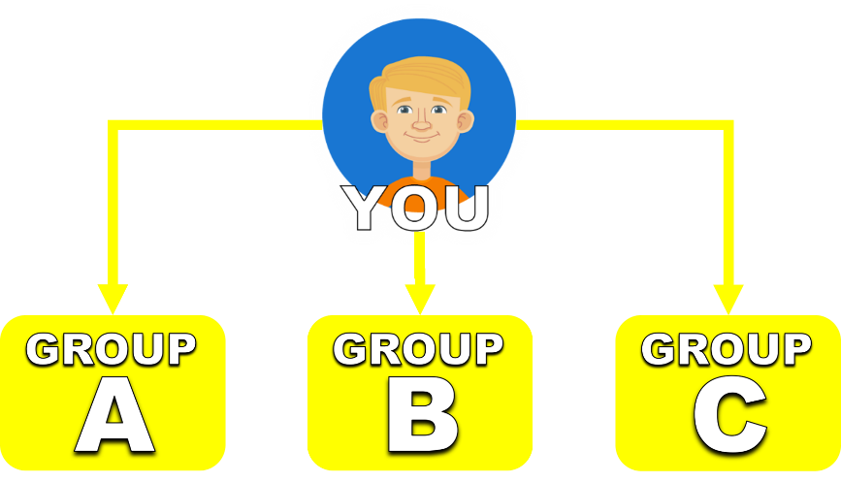
Team Sales Bonus
TO EARN TEAM SALES BONUS,
YOU NEED TO DEVELOP A MINIMUM OF TWO SALES GROUP
UP TO A MAXIMUM OF THREE
Team Sales Bonus
is paid based on
POINTS
3 POINTS
Notes:
TOP RIGHT

Slide 40

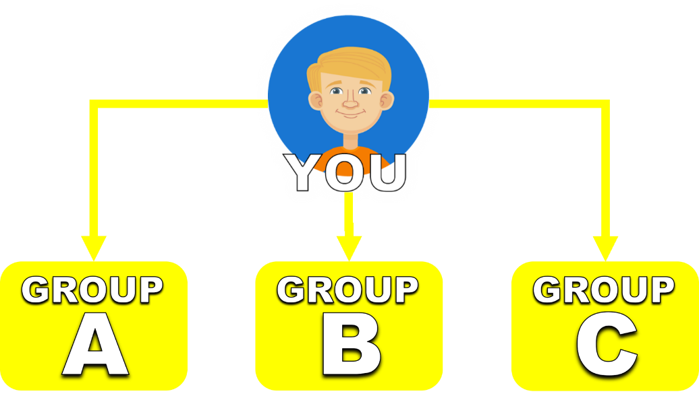
Team Sales Bonus
TO EARN TEAM SALES BONUS,
YOU NEED TO DEVELOP A MINIMUM OF TWO SALES GROUP
UP TO A MAXIMUM OF THREE
Team Sales Bonus
is paid based on
POINTS
3 POINTS
SMH PAYS:
P400.00
PER PAIRED POINT
Notes:
TOP RIGHT

Slide 41

Team Sales Bonus
TO EARN TEAM SALES BONUS,
YOU NEED TO DEVELOP A MINIMUM OF TWO SALES GROUP
UP TO A MAXIMUM OF THREE
Team Sales Bonus
is paid based on
POINTS
3 POINTS
20 POINTS
Notes:
TOP RIGHT

Slide 42

Team Sales Bonus
TO EARN TEAM SALES BONUS,
YOU NEED TO DEVELOP A MINIMUM OF TWO SALES GROUP UP TO A MAXIMUM OF THREE
Team Sales Bonus
is paid based on
POINTS
SMH PAYS:
P400.00
PER PAIRED POINT
3 POINTS
3 POINTS
3 PAIRED POINTS
P1,200.00
Notes:
NO CAM
30 x 400 = 12000 50 x 400 = 20000

Slide 43
Team Sales Bonus
TO EARN TEAM SALES BONUS,
YOU NEED TO DEVELOP A MINIMUM OF TWO SALES GROUP UP TO A MAXIMUM OF THREE
Team Sales Bonus
is paid based on
POINTS
SMH PAYS:
P400.00
PER PAIRED POINT
3 POINTS
3 POINTS
YOU’LL EARN A BINARY PAIRING ANYTIME YOU HAVE TWO SALES GROUPS PAIRED UP
3 PAIRED POINTS
P1,200.00
Notes:
NO CAM
30 x 400 = 12000 50 x 400 = 20000

Slide 44
Team Sales Bonus
TO EARN TEAM SALES BONUS,
YOU NEED TO DEVELOP A MINIMUM OF TWO SALES GROUP UP TO A MAXIMUM OF THREE
Team Sales Bonus
is paid based on
POINTS
SMH PAYS:
P400.00
PER PAIRED POINT
3 POINTS
3 POINTS
YOU’LL EARN A BINARY PAIRING ANYTIME YOU HAVE TWO SALES GROUPS PAIRED UP
BINARY
3 PAIRED POINTS
P1,200.00
Notes:
NO CAM
30 x 400 = 12000 50 x 400 = 20000

Slide 45
Team Sales Bonus
TO EARN TEAM SALES BONUS,
YOU NEED TO DEVELOP A MINIMUM OF TWO SALES GROUP UP TO A MAXIMUM OF THREE
Team Sales Bonus
is paid based on
POINTS
SMH PAYS:
P400.00
PER PAIRED POINT
3 POINTS
3 POINTS
YOU’LL EARN A BINARY PAIRING ANYTIME YOU HAVE TWO SALES GROUPS PAIRED UP
BINARY
Notes:
NO CAM
30 x 400 = 12000 50 x 400 = 20000

Slide 46
Team Sales Bonus
TO EARN TEAM SALES BONUS,
YOU NEED TO DEVELOP A MINIMUM OF TWO SALES GROUP UP TO A MAXIMUM OF THREE
Team Sales Bonus
is paid based on
POINTS
SMH PAYS:
P400.00
PER PAIRED POINT
3 POINTS
3 POINTS
TRINARY IS PAID WHEN 3 SALES GROUPS PRODUCED POINTS SIMULTANEOUSLY WITHIN THE ONE-HOUR PROCESSING PERIOD.
BINARY
Notes:
NO CAM
30 x 400 = 12000 50 x 400 = 20000

Slide 47
Team Sales Bonus
TO EARN TEAM SALES BONUS,
YOU NEED TO DEVELOP A MINIMUM OF TWO SALES GROUP UP TO A MAXIMUM OF THREE
Team Sales Bonus
is paid based on
POINTS
SMH PAYS:
P400.00
PER PAIRED POINT
3 POINTS
8 POINTS
12 POINTS
TRINARY IS PAID WHEN 3 SALES GROUPS PRODUCED POINTS SIMULTANEOUSLY WITHIN THE ONE-HOUR PROCESSING PERIOD.
THE SYSTEM FIRST LOOKS FOR THE GROUP WITH THE HIGHEST POINT PRODUCTION
Notes:
NO CAM
30 x 400 = 12000 50 x 400 = 20000

Slide 48
Team Sales Bonus
TO EARN TEAM SALES BONUS,
YOU NEED TO DEVELOP A MINIMUM OF TWO SALES GROUP UP TO A MAXIMUM OF THREE
Team Sales Bonus
is paid based on
POINTS
SMH PAYS:
P400.00
PER PAIRED POINT
3 POINTS
8 POINTS
12 POINTS
TRINARY IS PAID WHEN 3 SALES GROUPS PRODUCED POINTS SIMULTANEOUSLY WITHIN THE ONE-HOUR PROCESSING PERIOD.
THE SYSTEM FIRST LOOKS FOR THE GROUP WITH THE HIGHEST POINT PRODUCTION
Notes:
NO CAM
30 x 400 = 12000 50 x 400 = 20000

Slide 49
Team Sales Bonus
TO EARN TEAM SALES BONUS,
YOU NEED TO DEVELOP A MINIMUM OF TWO SALES GROUP UP TO A MAXIMUM OF THREE
Team Sales Bonus
is paid based on
POINTS
SMH PAYS:
P400.00
PER PAIRED POINT
3 POINTS
8 POINTS
12 POINTS
TRINARY IS PAID WHEN 3 SALES GROUPS PRODUCED POINTS SIMULTANEOUSLY WITHIN THE ONE-HOUR PROCESSING PERIOD.
Notes:
NO CAM
30 x 400 = 12000 50 x 400 = 20000

Slide 50


Team Sales Bonus
TO EARN TEAM SALES BONUS,
YOU NEED TO DEVELOP A MINIMUM OF TWO SALES GROUP UP TO A MAXIMUM OF THREE
Team Sales Bonus
is paid based on
POINTS
SMH PAYS:
P400.00
PER PAIRED POINT
3 POINTS
8 POINTS
12 POINTS
TRINARY IS PAID WHEN 3 SALES GROUPS PRODUCED POINTS SIMULTANEOUSLY WITHIN THE ONE-HOUR PROCESSING PERIOD.
Notes:
NO CAM
30 x 400 = 12000 50 x 400 = 20000

Slide 51
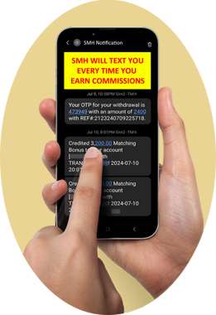
Team Sales Bonus
TO EARN TEAM SALES BONUS,
YOU NEED TO DEVELOP A MINIMUM OF TWO SALES GROUP UP TO A MAXIMUM OF THREE
Team Sales Bonus
is paid based on
POINTS
SMH PAYS:
P400.00
PER PAIRED POINT
3 POINTS
8 POINTS
12 POINTS
TRINARY IS PAID WHEN 3 SALES GROUPS PRODUCED POINTS SIMULTANEOUSLY WITHIN THE ONE-HOUR PROCESSING PERIOD.
8 PAIRS
P3,200.00
3 PAIRS
P1,200.00
Notes:
NO CAM
30 x 400 = 12000 50 x 400 = 20000

Slide 52
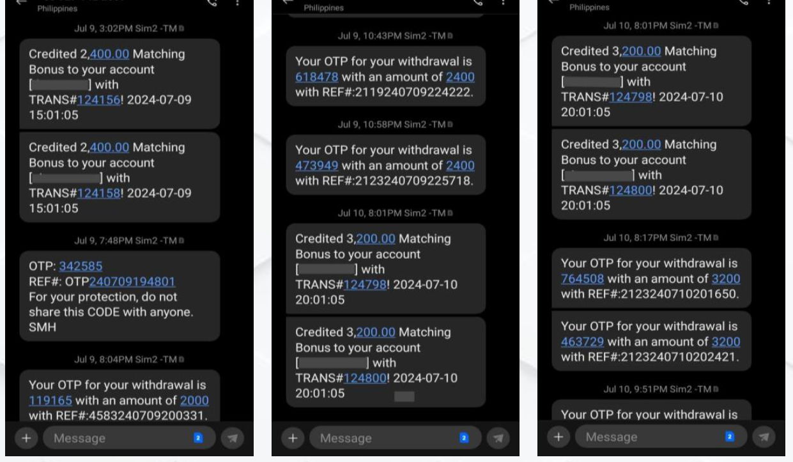
Notes:
MAGANDA ANG SYSTEM COMPARED TO OTHER PROGRAMS MAS MAGANDA PA TAYO

Slide 53
THE SMH PAYPLAN
ADVANTAGE
Notes:
TOP RIGHT

Slide 54

THE SMH PAYPLAN
ADVANTAGE
HIGH PAIRING BONUS
Other Companies:
P7,000.00 entry only pays P1,000.00/pair
WITH SMH:
P6,980.00 entry pays
P1,200.00 per pair
Notes:
TOP RIGHT

Slide 55
THE SMH PAYPLAN
ADVANTAGE
HIGH PAIRING BONUS
THEY LIMIT YOUR CAPACITY TO EARN
Other Companies:
P7,000.00 entry only pays P1,000.00/pair
WITH SMH:
P6,980.00 entry pays P1,200.00/pair
Notes:
TOP RIGHT

Slide 56

THE SMH PAYPLAN
ADVANTAGE
HIGH PAIRING BONUS
THEY LIMIT YOUR CAPACITY TO EARN
Other Companies:
P7,000.00 entry only pays P1,000.00/pair
YOU ARE ONLY ALLOWED TO EARN UP TO 10 PAIRS A DAY
FLUSHOUT
WITH SMH:
P6,980.00 entry pays P1,200.00/pair
Notes:
TOP RIGHT

Slide 57
THE SMH PAYPLAN
ADVANTAGE
X
X
THEY LIMIT YOUR CAPACITY TO EARN
Other Companies:
P7,000.00 entry only pays P1,000.00/pair
YOU ARE ONLY ALLOWED TO EARN UP TO 10 PAIRS A DAY
FLUSHOUT
WITH SMH:
P6,980.00 entry pays P1,200.00/pair
Notes:
TOP RIGHT

Slide 58
THE SMH PAYPLAN
ADVANTAGE
X
X
WITH SMH:
P6,980.00 entry pays P1,200.00/pair
Other Companies:
P7,000.00 entry only pays P1,000.00/pair
YOU ARE ONLY ALLOWED TO EARN UP TO 10 PAIRS A DAY
FLUSHOUT
NO MAXIMUM PAIRS PER DAY
100% STRONG LEG RETENTION
Notes:
WHAT MORE CAN YOU ASK FOR?

Slide 59
WITH SMH:
P6,980.00 entry pays P1,200.00/pair
THE SMH PAYPLAN
ADVANTAGE
NO MAXIMUM
PAIRS PER DAY
P24,000.000
300 POINTS
60 POINTS
100% STRONG
LEG RETENTION
60
PAIRS
BINARY
Notes:
WHAT MORE CAN YOU ASK FOR?

Slide 60
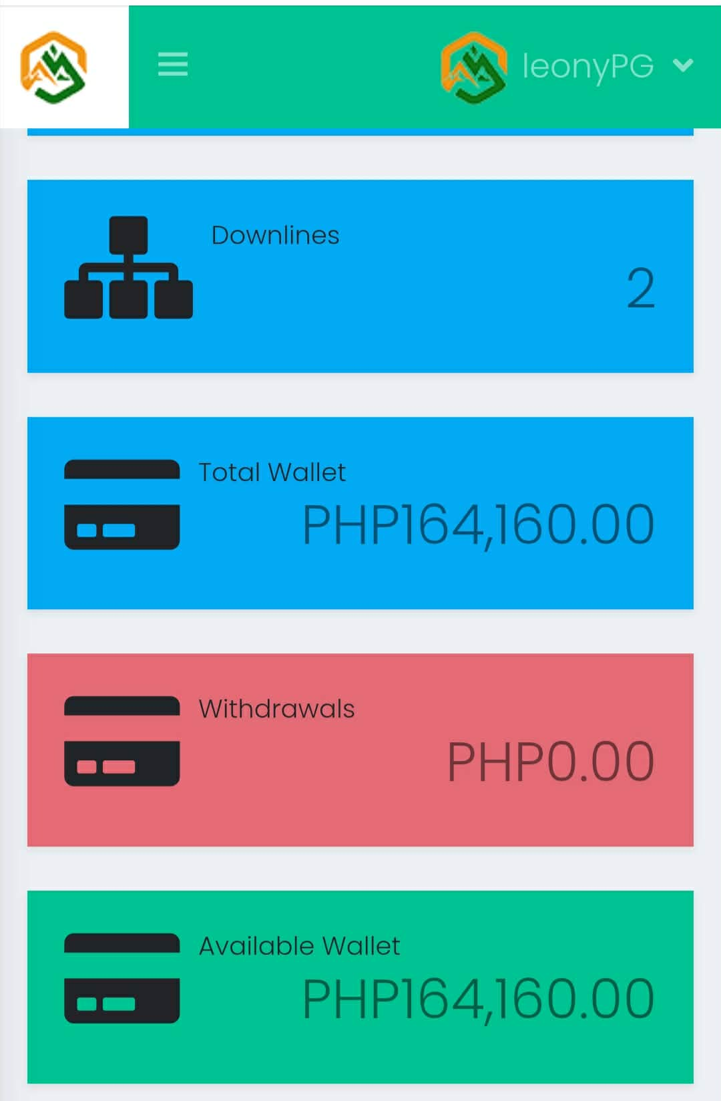
WITH SMH:
P6,980.00 entry pays P1,200.00/pair
THE SMH PAYPLAN
ADVANTAGE
NO MAXIMUM
PAIRS PER DAY
P160,000.000
500 POINTS
400 POINTS
100% STRONG
LEG RETENTION
400
PAIRS
Notes:
WHAT MORE CAN YOU ASK FOR?

Slide 61
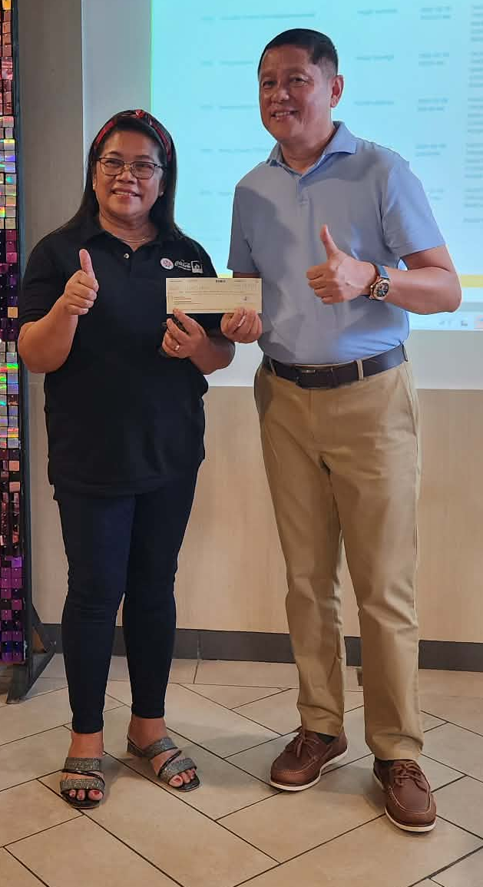
P160,000.000
500 POINTS
400 POINTS
400
PAIRS
Notes:
WHAT MORE CAN YOU ASK FOR?

Slide 62

Twinkle Banderado

Slide 63


Slide 64
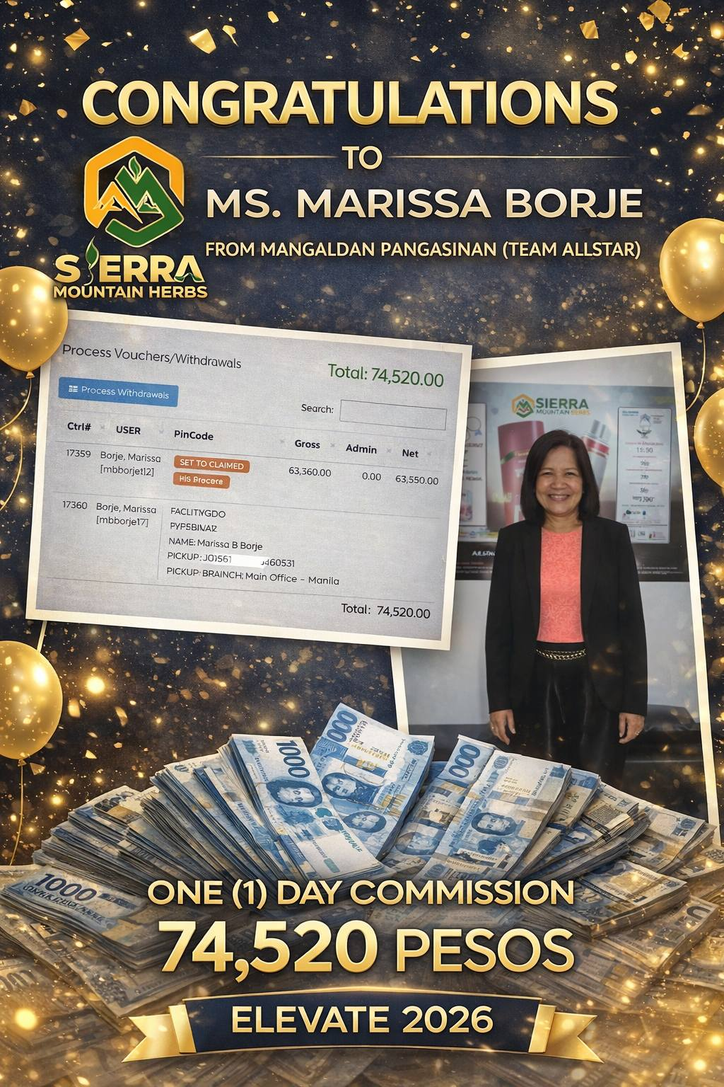

Slide 65


Slide 66
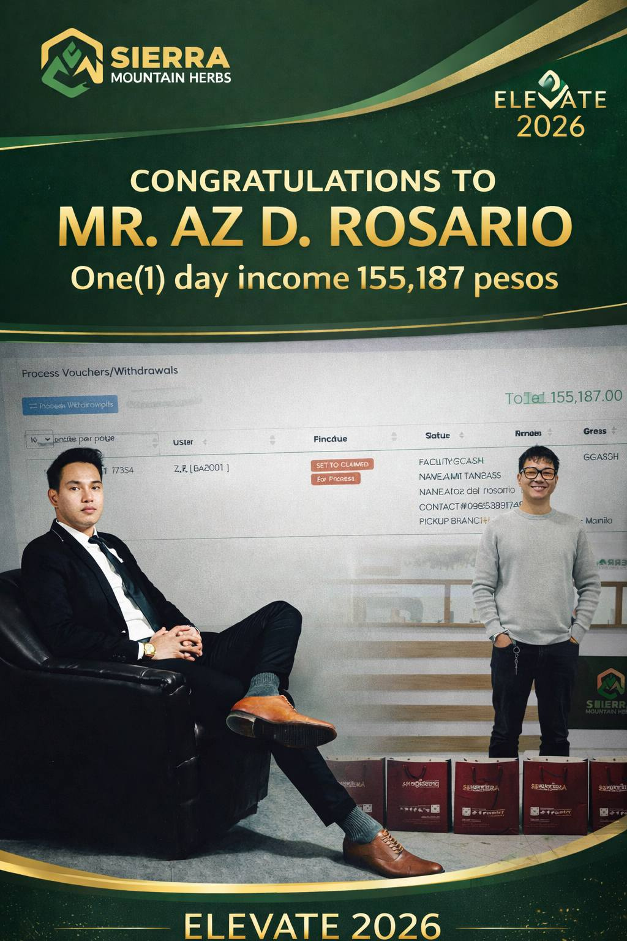

Slide 67


Slide 68
THE SMH PAYPLAN
ADVANTAGE
X
X
WITH SMH:
P6,980.00 entry pays P1,200.00/pair
Other Companies:
P7,000.00 entry only pays P1,000.00/pair
YOU ARE ONLY ALLOWED TO EARN UP TO 10 PAIRS A DAY
FLUSHOUT
NO MAXIMUM PAIRS PER DAY
100% STRONG LEG RETENTION
Notes:
WHAT MORE CAN YOU ASK FOR?

Slide 69
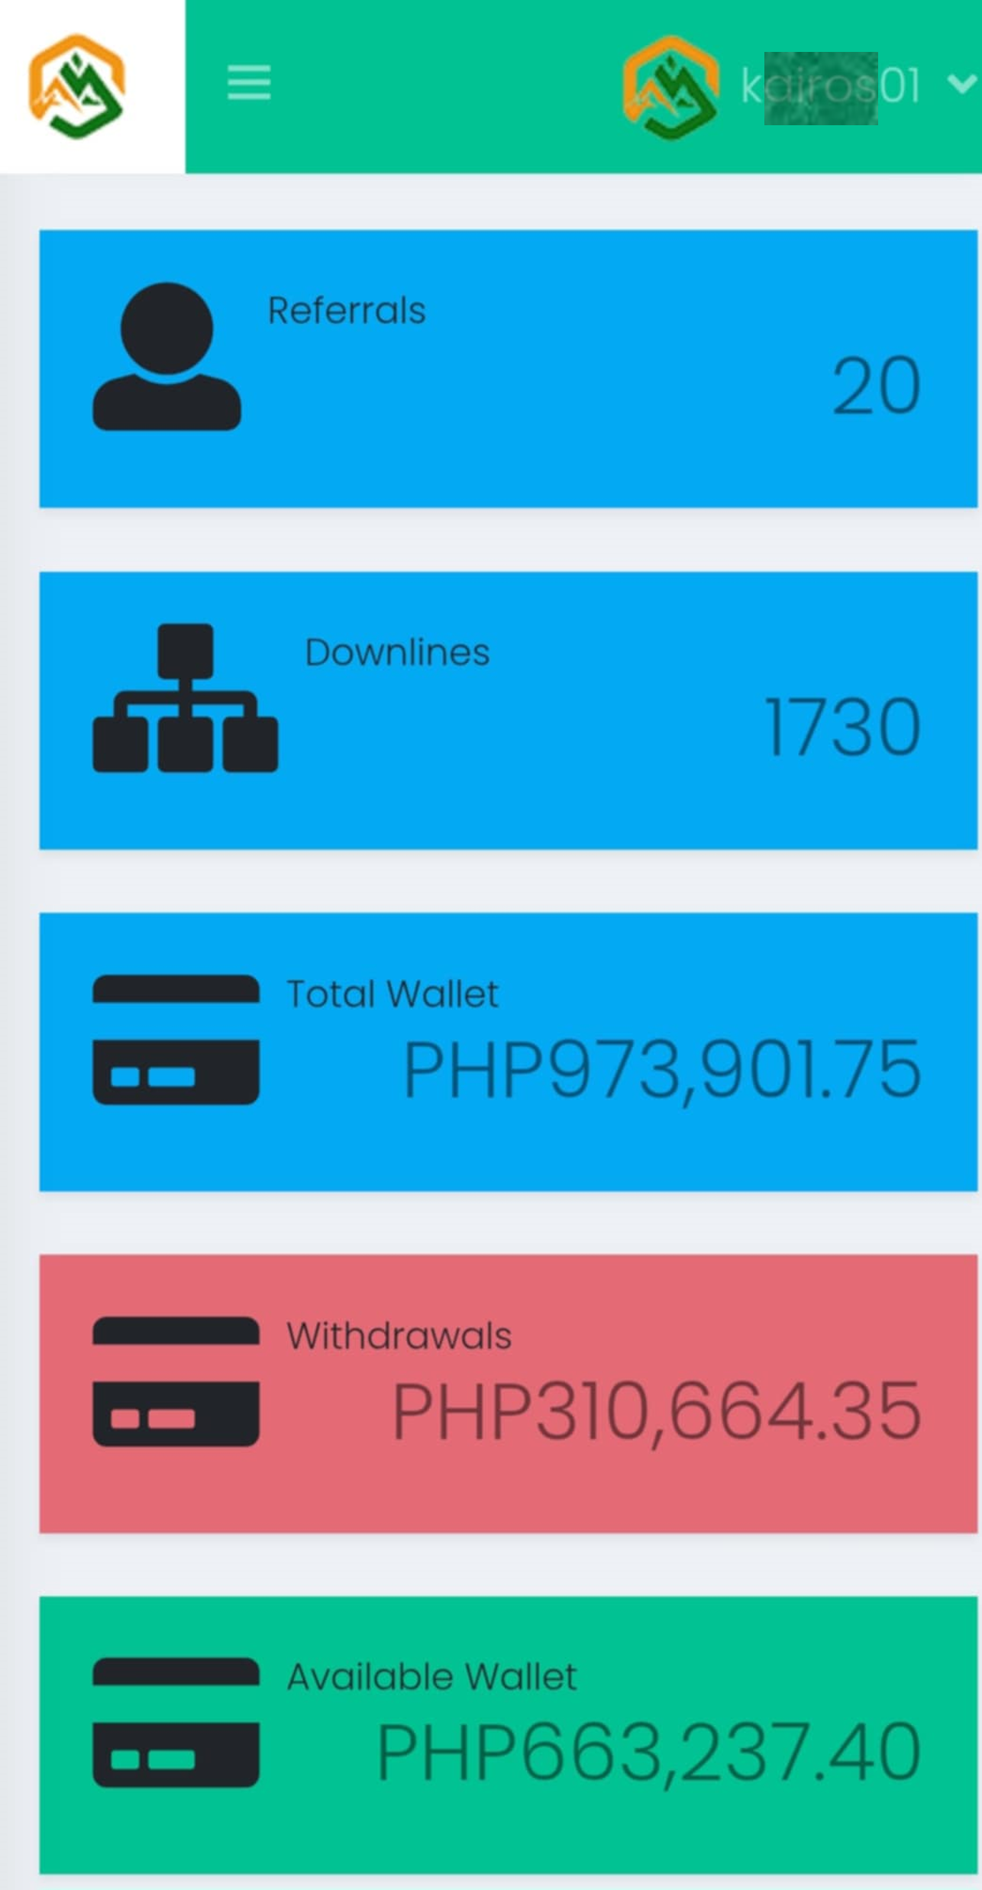
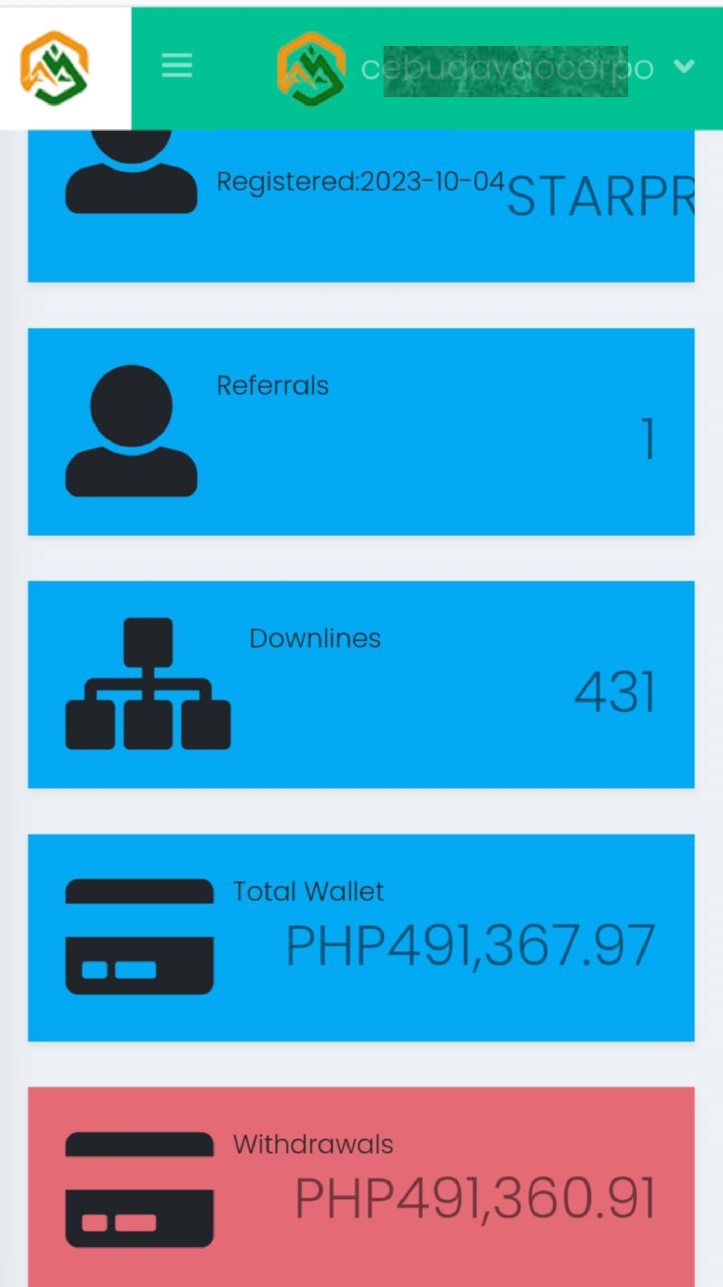
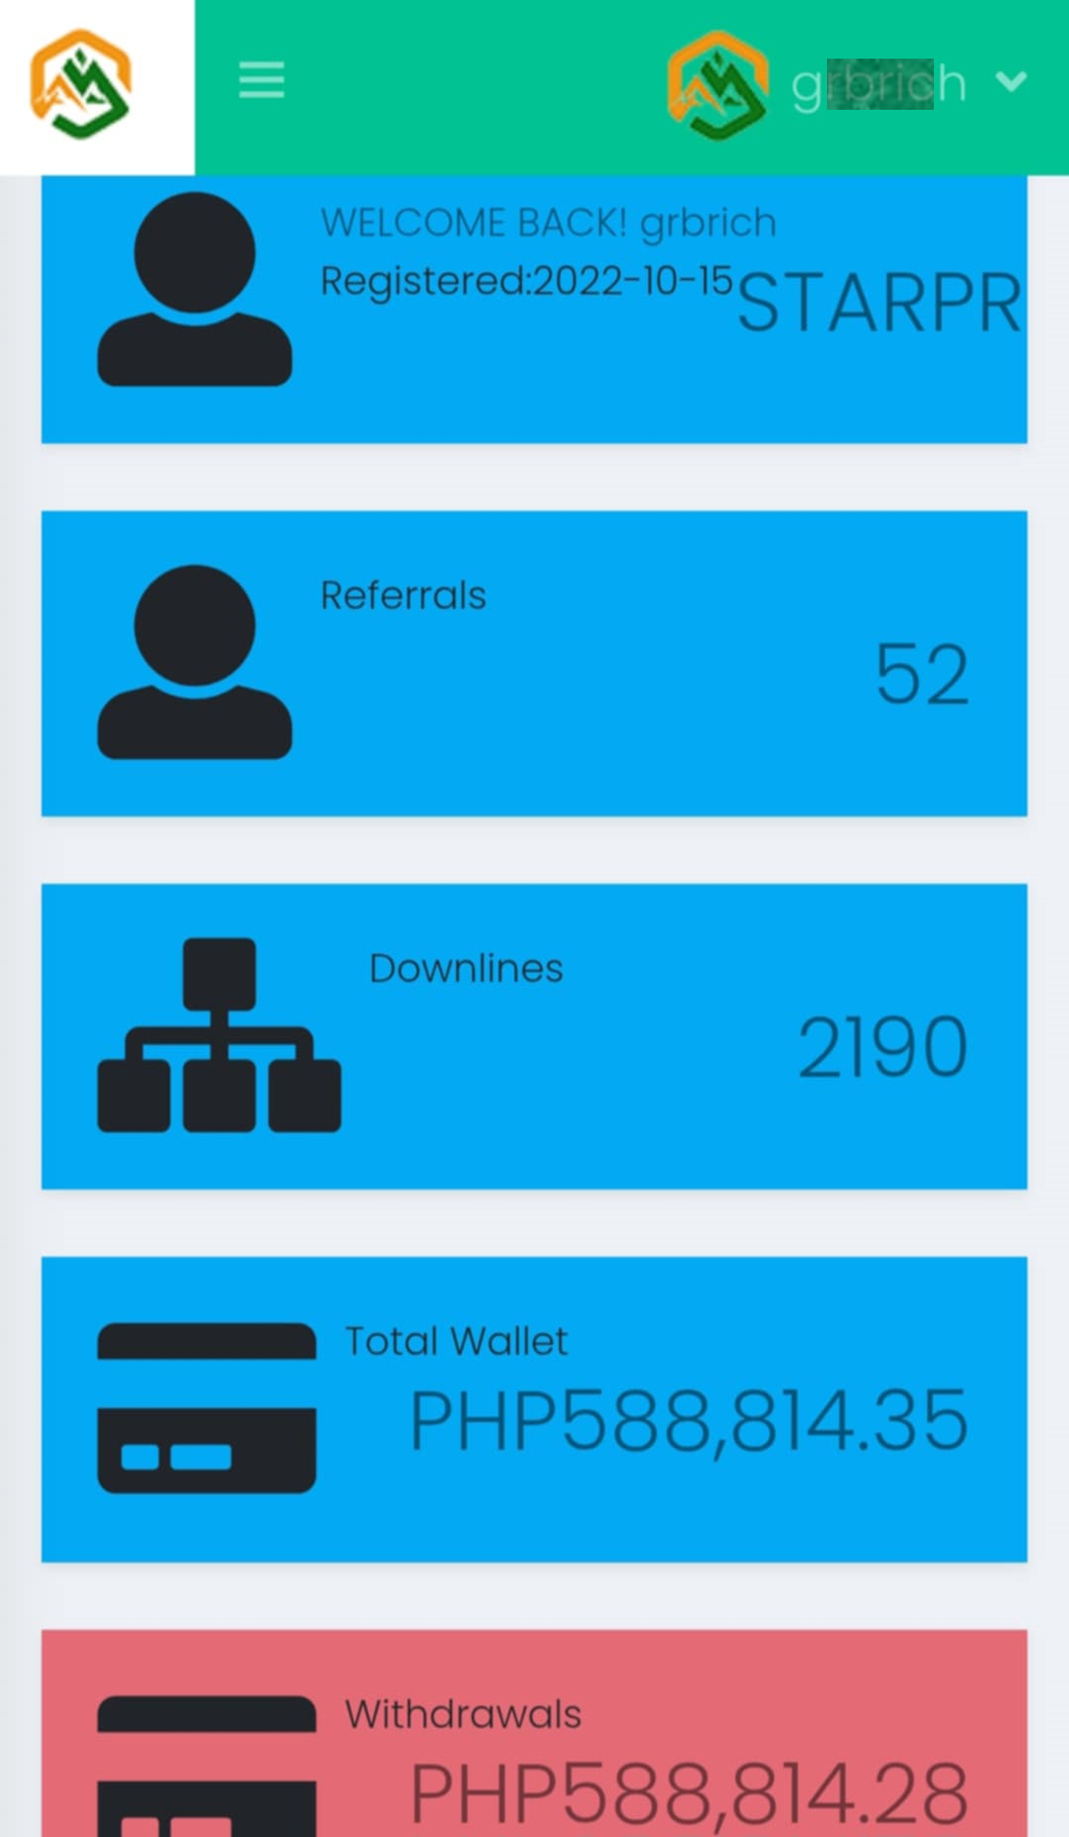
Notes:
NAPAKA GANDANG NEGOSYO PERO HINDI MO ITO GAGAWIN NG MAG-ISA. ITO ANG NEGOSYO NA MAY SYSTEMA. COMPARE SA RESTAURANT = I OPERATE = PAGOD. DITO MAY KASAMA KA.

Slide 70


Team Sales Bonus
THE SMH PAYPLAN ADVANTAGE
TO EARN TEAM SALES BONUS,
YOU NEED TO DEVELOP A MINIMUM OF TWO SALES GROUP UP TO A MAXIMUM OF THREE
BINARY – TRINARY PAY PLAN
HIGH PAIRING BONUS
HOURLY PAYOUT
SMS PAYOUT NOTIFICATION
5TH PAIR
DEDUCTION
Notes:
TOP RIGHT

Slide 71

Team Sales Bonus
THE SMH PAYPLAN ADVANTAGE
TO EARN TEAM SALES BONUS,
YOU NEED TO DEVELOP A MINIMUM OF TWO SALES GROUP UP TO A MAXIMUM OF THREE
BINARY – TRINARY PAY PLAN
HIGH PAIRING BONUS
HOURLY PAYOUT
SMS PAYOUT NOTIFICATION
5TH PAIR
DEDUCTION
WILL BECOME LIFESTYLE
REWARDS
INSIDE YOUR DASHBOARD
REDEEM PRODUCTS OR GADGETS
Notes:
NAPAKA GANDA PO NG PROGRAMA NATIN AT MAY RESULTA. MADAMI NG KUMIKITA DITO SA ATIN.
SAMPLE.

Slide 72


Slide 73
Team Sales Bonus
TO EARN TEAM SALES BONUS,
YOU NEED TO DEVELOP A MINIMUM OF TWO SALES GROUP
UP TO A MAXIMUM OF THREE
Team Sales Bonus
is paid based on
POINTS
SMH PAYS:
P400.00
PER PAIRED POINT
3 POINTS
PRODUCTS
RE-PURCHASE
ALSO HAS POINTS
Notes:
TOP RIGHT

Slide 74
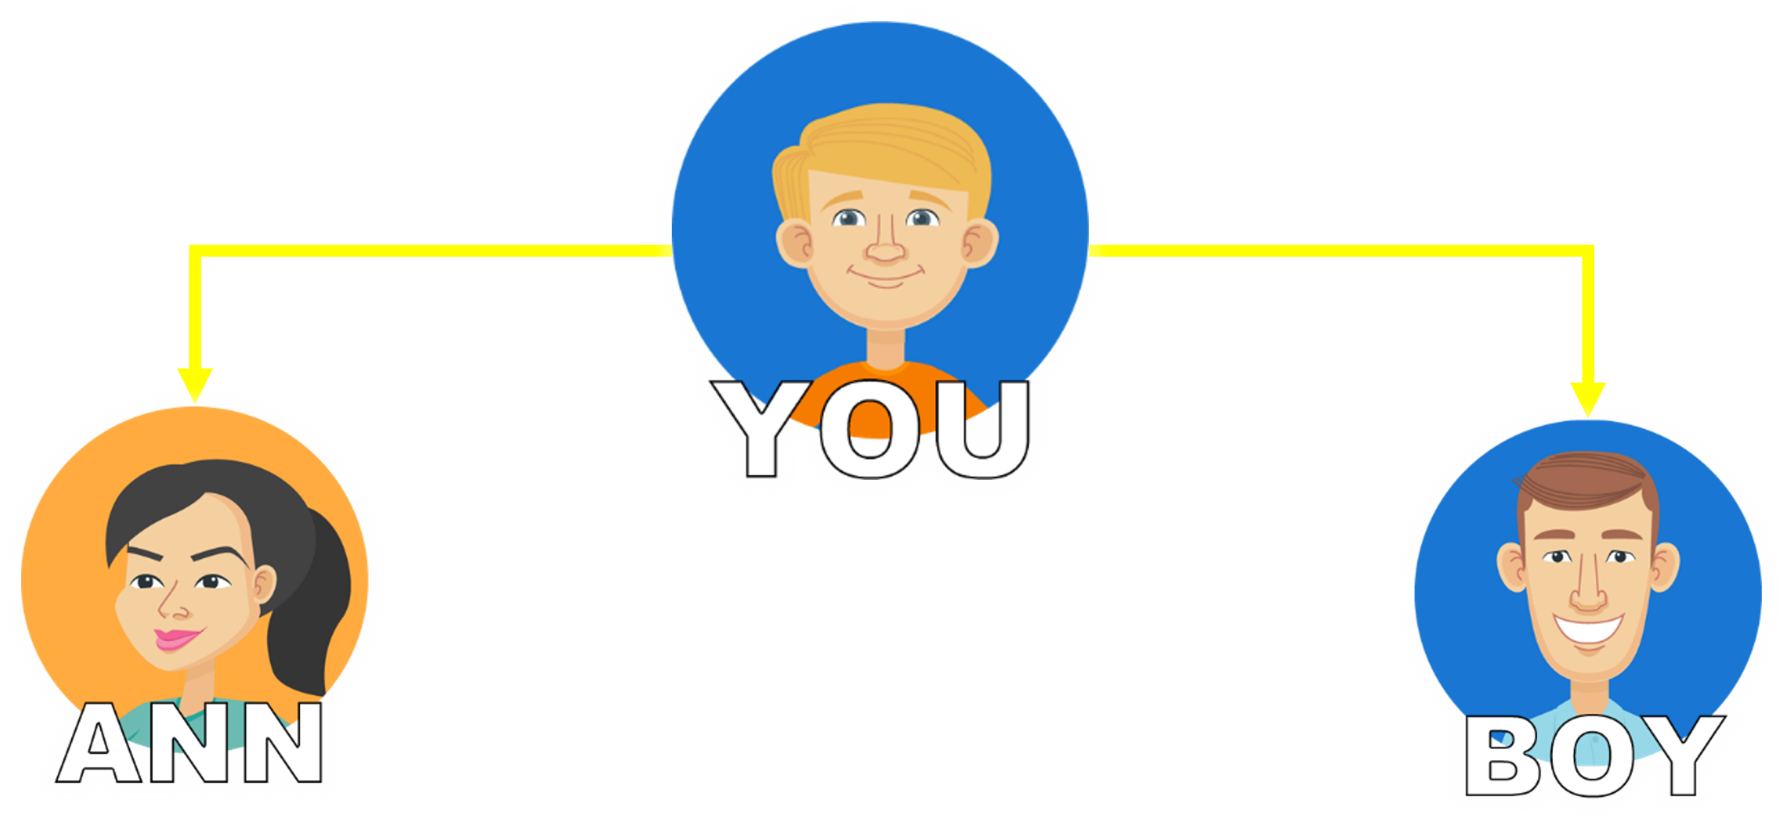

Team Sales Bonus
TO EARN TEAM SALES BONUS,
YOU NEED TO DEVELOP A MINIMUM OF TWO SALES GROUP UP TO A MAXIMUM OF THREE
Team Sales Bonus
is paid based on
POINTS
NO MAXIMUM PAIRS PER DAY
SMH PAYS:
P400.00
NO FLUSHOUT
PER PAIRED POINT
WILL
PAIR WITH
ALL
PRODUCT
ALL ENTRY PACKAGES
REPURCHASE
Notes:
NO CAM
30 x 400 = 12000 50 x 400 = 20000

Slide 75
Team Sales Bonus
TO EARN TEAM SALES BONUS,
YOU NEED TO DEVELOP A MINIMUM OF TWO SALES GROUP UP TO A MAXIMUM OF THREE
Team Sales Bonus
is paid based on
POINTS
NO MAXIMUM PAIRS PER DAY
SMH PAYS:
P400.00
NO FLUSHOUT
PER PAIRED POINT
WILL
PAIR WITH
ALL
ALL
PRODUCT
PRODUCT
REPURCHASE
REPURCHASE
Notes:
NO CAM
30 x 400 = 12000 50 x 400 = 20000

Slide 76

Team Sales Bonus
TO EARN TEAM SALES BONUS,
YOU NEED TO DEVELOP A MINIMUM OF TWO SALES GROUP UP TO A MAXIMUM OF THREE
Team Sales Bonus
is paid based on
POINTS
NO MAXIMUM PAIRS PER DAY
SMH PAYS:
P400.00
NO FLUSHOUT
PER PAIRED POINT
WILL
PAIR WITH
3,000
5,000
downlines
downlines
Notes:
NO CAM
30 x 400 = 12000 50 x 400 = 20000

Slide 77
Team Sales Bonus
TO EARN TEAM SALES BONUS,
YOU NEED TO DEVELOP A MINIMUM OF TWO SALES GROUP UP TO A MAXIMUM OF THREE
Team Sales Bonus
is paid based on
POINTS
NO MAXIMUM PAIRS PER DAY
SMH PAYS:
P400.00
NO FLUSHOUT
PER PAIRED POINT
WILL
PAIR WITH
3,000
5,000
downlines
downlines
Notes:
NO CAM
30 x 400 = 12000 50 x 400 = 20000

Slide 78
Team Sales Bonus
TO EARN TEAM SALES BONUS,
YOU NEED TO DEVELOP A MINIMUM OF TWO SALES GROUP UP TO A MAXIMUM OF THREE
Team Sales Bonus
is paid based on
POINTS
NO MAXIMUM PAIRS PER DAY
SMH PAYS:
P400.00
NO FLUSHOUT
PER PAIRED POINT
WILL
PAIR WITH
3,000
5,000
downlines
downlines
2,000 PAX
buys P1,000.00 worth of repeat purchase
P60,000.00
TSB - Binary
Notes:
LONG TERM RESIDUAL INCOME
COMES FROM PRODUCT USAGE
RESIDUAL INCOME
30 x 400 = 12000 50 x 400 = 20000

Slide 79


REWARDS
PERFORMANCE

Slide 80

Where performance turns into profit
Notes:
SMH rewards distributors who perform and contribute to the growth of the company

Slide 81
RANK UP BONUS
Where performance turns into profit
SUPERVISOR
GLOBAL PROSELLER
MANAGER
EXEC. MANAGER
HALL OF FAMER
DIRECTOR
EXEC. DIRECTOR

Slide 82

RANK UP BONUS
Where performance turns into profit
SUPERVISOR
* Rank Up Bonus — ₱12,000.00 & now boosted to ₱25,000.00 for a limited time only
* 75 pairs (packages)
* 25 pairs (repeat purchase)
MANAGER
* Rank Up Bonus — ₱25,000.00 & now boosted to ₱50,000.00 for a limited time only
* 150 pairs (packages)
* 50 pairs (repeat purchase)
Notes:
SUPERVISOR = P40,000.00

Slide 83
RANK UP BONUS
Where performance turns into profit
EXEC. MANAGER
* Rank Up Bonus — ₱50,000.00 & now boosted to ₱100,000.00 for a limited time only
* 300 pairs (packages)
* 100 pairs (repeat purchase)
DIRECTOR
* Rank Up Bonus — ₱100,000.00 now boosted to ₱200,000.00 for a limited time only
* 600 pairs (packages)
* 100 pairs (repeat purchase)

Slide 84

RANK UP BONUS
Where performance turns into profit
EXEC. DIRECTOR
* Rank Up Bonus — ₱200,000.00 now boosted to ₱400,000.00 for a limited time only
* 1,200 pairs (packages)
* 200 pairs (repeat purchase)
GLOBAL PROSELLER
* Rank Up Bonus — ₱500,000.00 now boosted to ₱1,000,000.00 for a limited time only
* 2,400 pairs (packages)
* 400 pairs (repeat purchase)

Slide 85
RANK UP BONUS
Where performance turns into profit
HALL OF FAMER
* 4,800 pairs (packages)
* 800 pairs (repeat purchase)
Rank Up Bonus — ₱1,000,000.00
now boosted to ₱2,000,000.00 for a limited time only

Slide 86
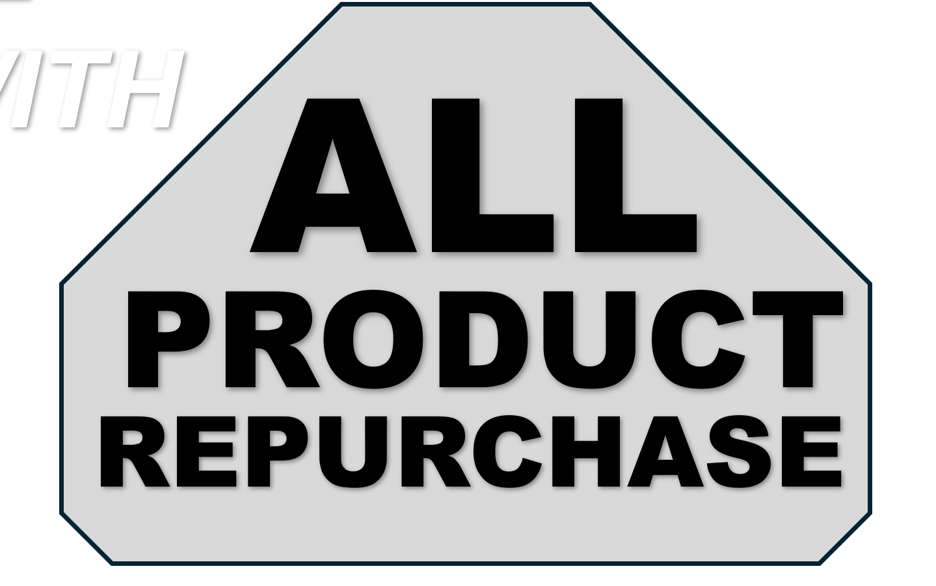

Income from Product Repeat Purchase
UNITREE
System

Slide 87

P2,650.00
UNITREE
Product
Bundles
Notes:
TOP RIGHT

Slide 88
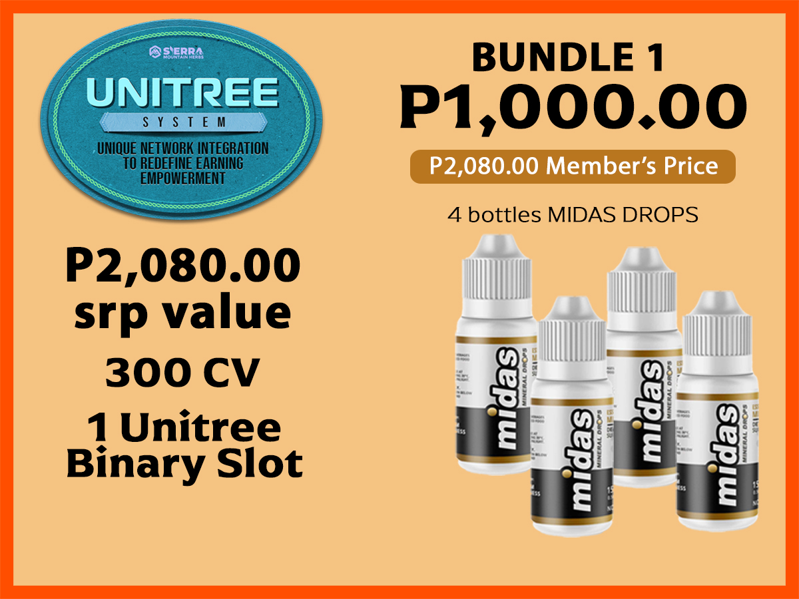
P1,000.00
UNITREE
Product
Bundles
Notes:
TOP RIGHT

Slide 89

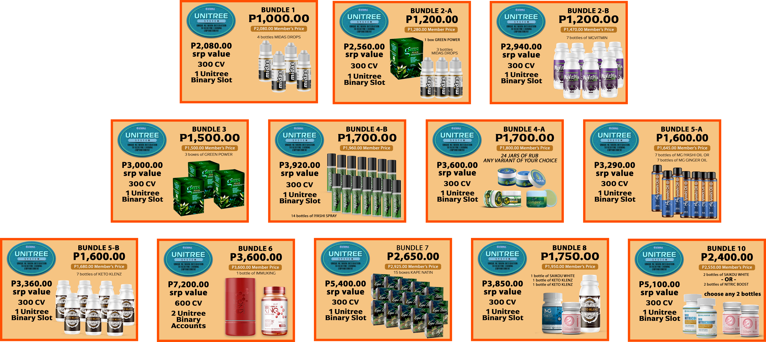
UNITREE System

Slide 90
UNITREE System
To Redefine Earning Empowerment
Unique Network Integration
Notes:
TOP RIGHT

Slide 91
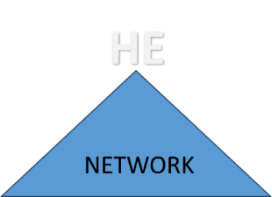
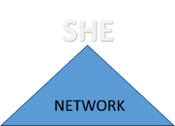
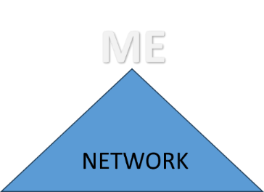
UNITREE System
Unique Network Integration
To Redefine Earning Empowerment
INTEGRATED
YOU
THEY
NETWORK
NETWORK
Notes:
TOP RIGHT

Slide 92
UNITREE System
Unique Network Integration
To Redefine Earning Empowerment
YOU
NETWORK
Notes:
TOP RIGHT

Slide 93
UNITREE System
Unique Network Integration
To Redefine Earning Empowerment
INTEGRATED
YOU
THEY
NETWORK
NETWORK
Notes:
TOP RIGHT

Slide 94

UNITREE System
INTEGRATED
YOU CAN BE THE UPLINE OF THE ENTIRE NETWORK OF SMH
LEFT
RIGHT
A distributor will get one UNITREE BINARY SLOT
for every purchase of
UNITREE Product Bundle
NO LIMIT OF PURCHASE
The more UNITREE Product Bundles you purchase, the more UNITREE Binary Slots you will have
The UNITREE Binary Structure
WILL BE RANDOMLY
ARRANGED BY OUR SYSTEM
Notes:
TOP LEFT

Slide 95
UNITREE System
INTEGRATED
EARN 10% OF PAIRED CV
LEFT
RIGHT
THE NETWORK STRUCTURE WILL BE RESHUFFLED EVERY MONTH TO ENSURE EQUAL OPPORTUNITIES FOR EVERYONE
500,000
CV
500,000
CV
EARN
10% OF PAIRED CV
P50,000.00
Notes:
TOP LEFT

Slide 96
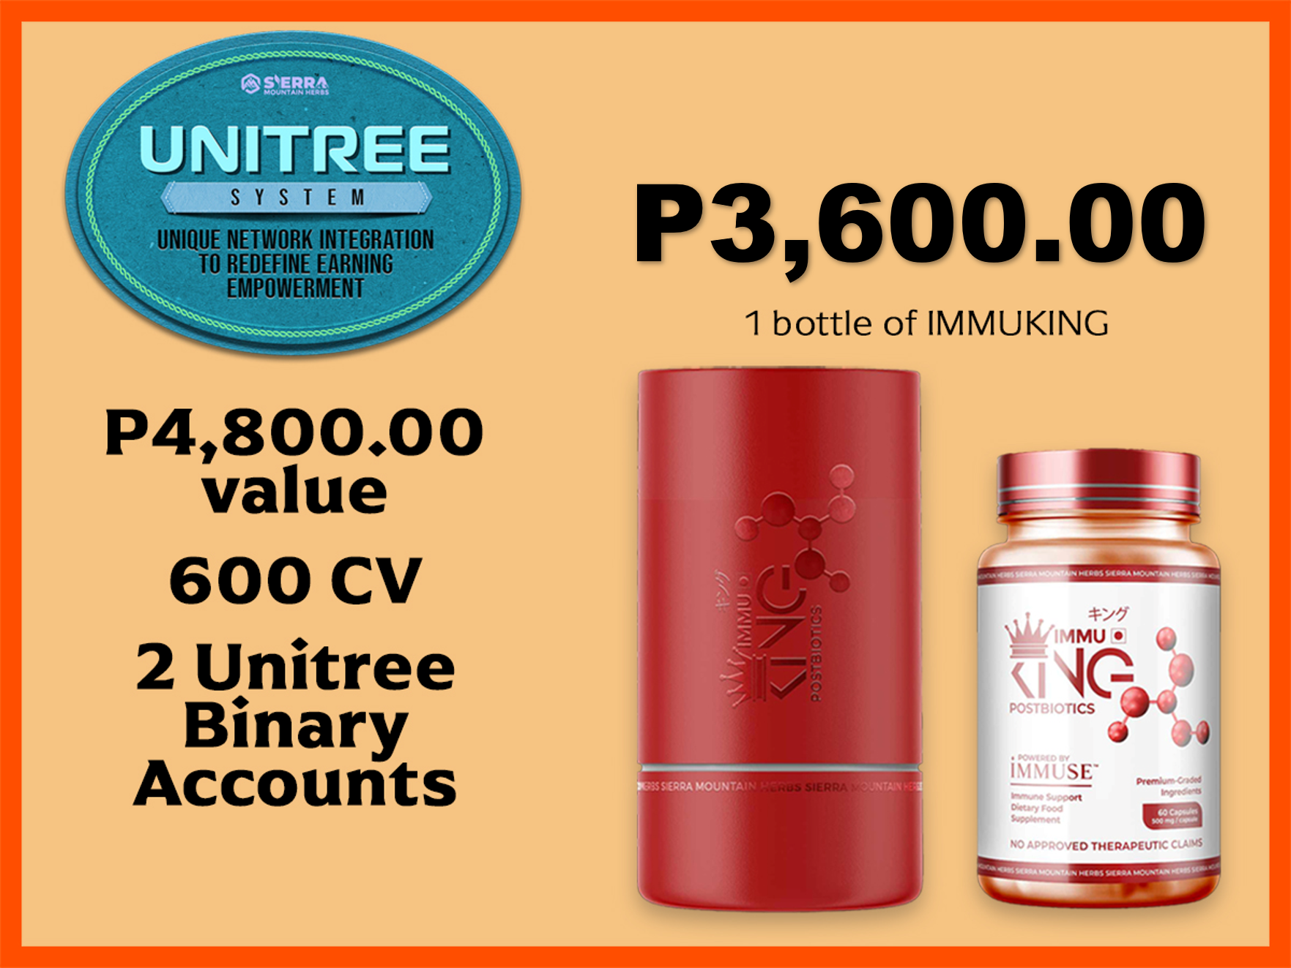
P3,600.00
P7,200.00
UNITREE
60 POINTS
Product
Bundles
Notes:
TOP RIGHT

Slide 97
P3,600.00 + P600 = P4,200
P7,200.00
60 POINTS
UNITREE
Product
Bundles
Notes:
TOP RIGHT

Slide 98


Slide 99
Thank You

Slide 102
SMH BUSINESS
IS NOW OPEN FOR
INTERNATIONAL
TRANSACTIONS

Slide 103


BE A DISTRIBUTOR
Notes:
TOP RIGHT

Slide 104

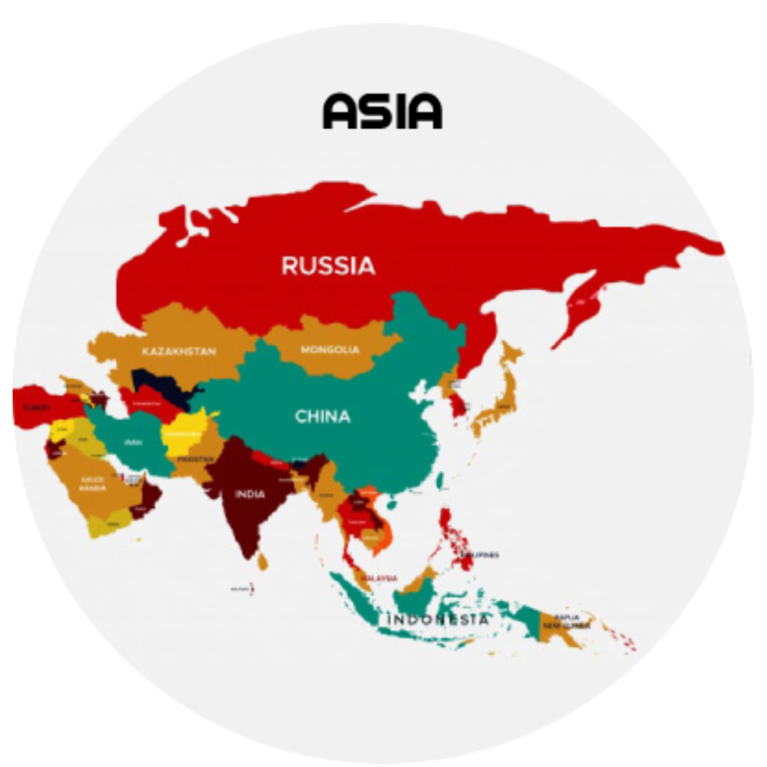
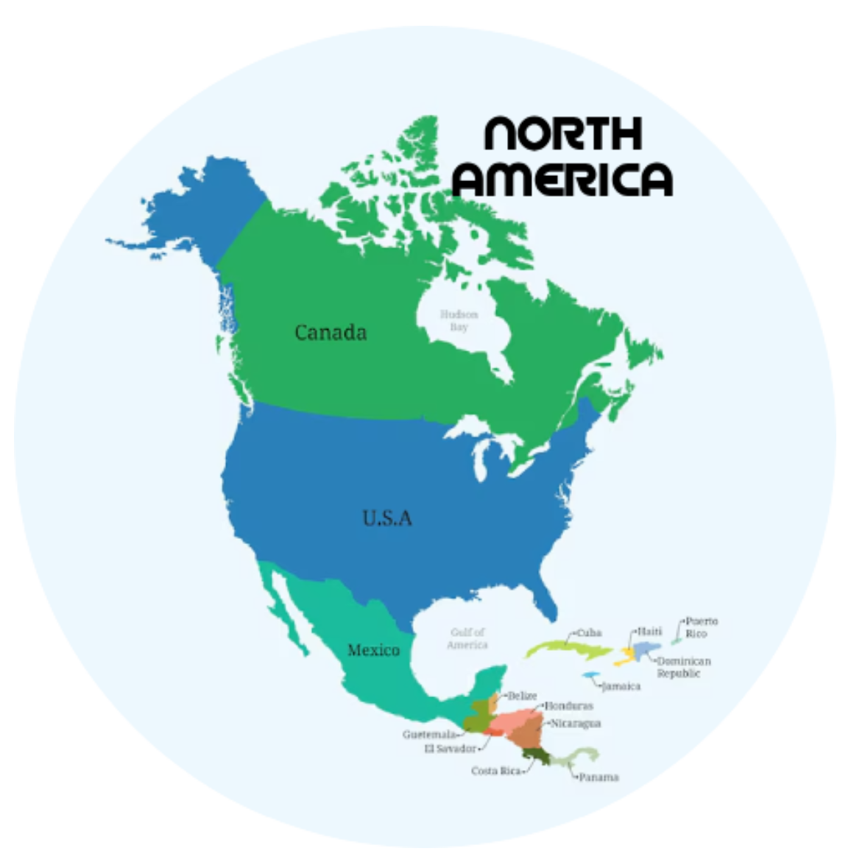

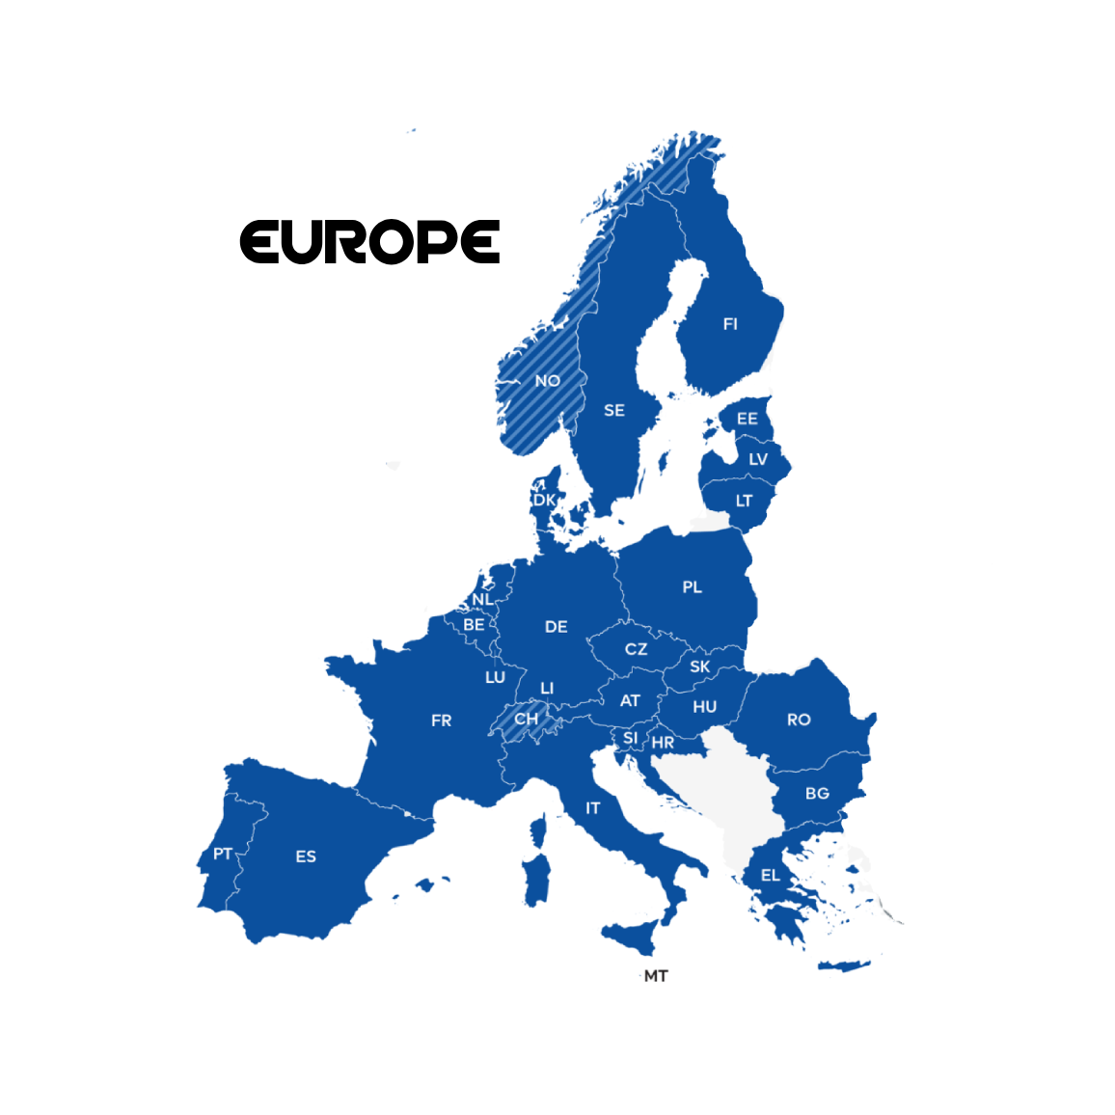
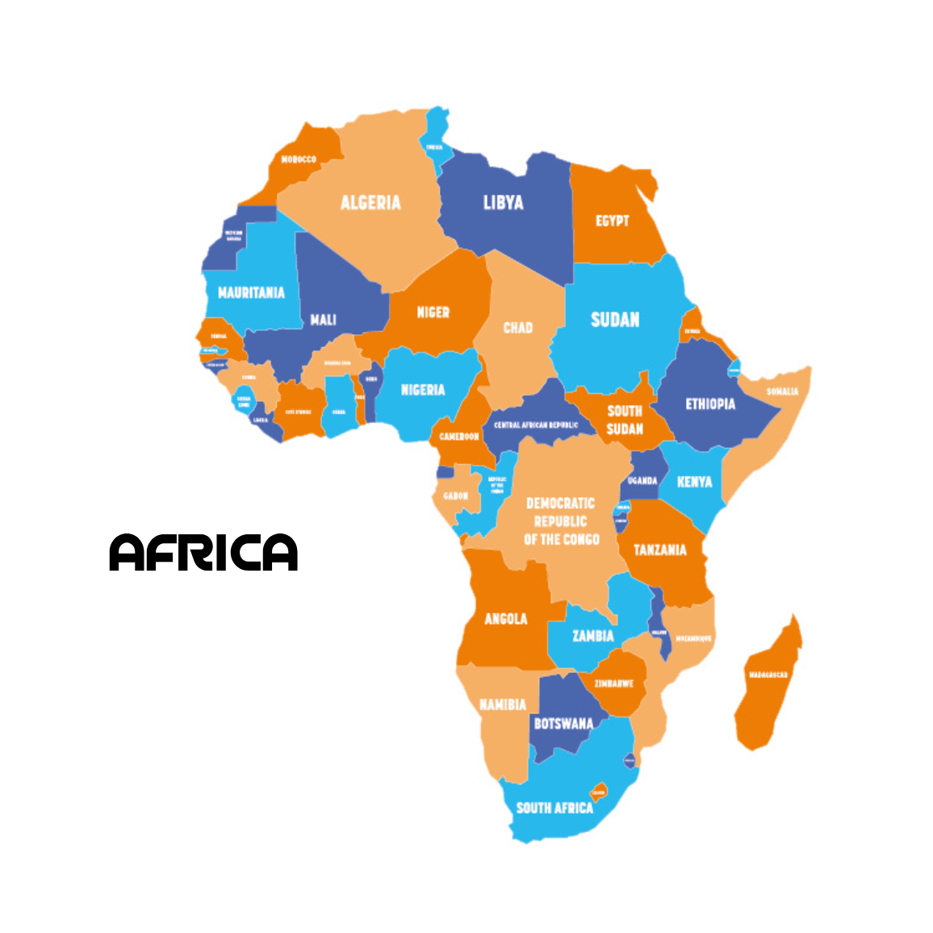
BE A DISTRIBUTOR
Australia & New Zealand
Asia
North America
Middle East
Europe
Africa
Notes:
LOW LEFT

Slide 105

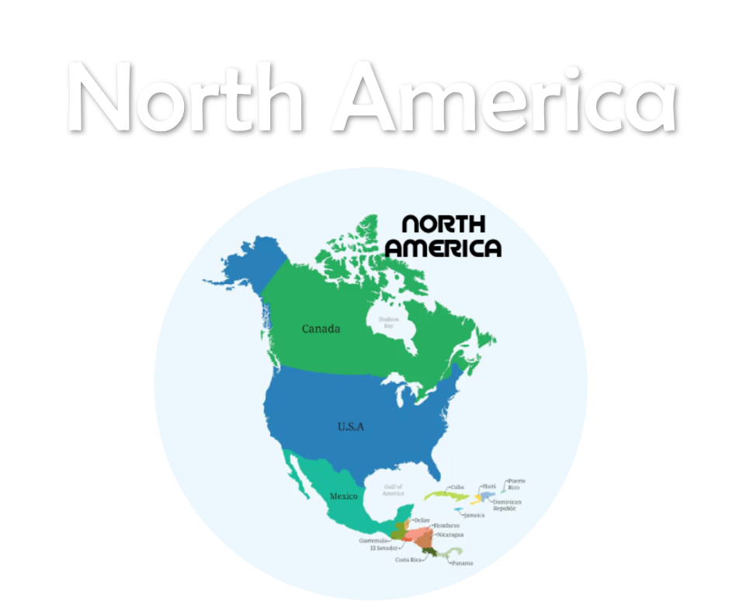



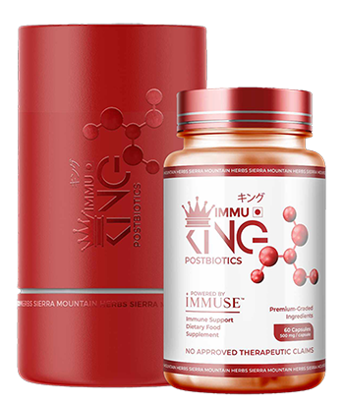

FREE
SHIPPING -
INTERNATIONAL
9 bottles
P70,000.00
P8,000/bot
Notes:
TOP RIGHT

Slide 106
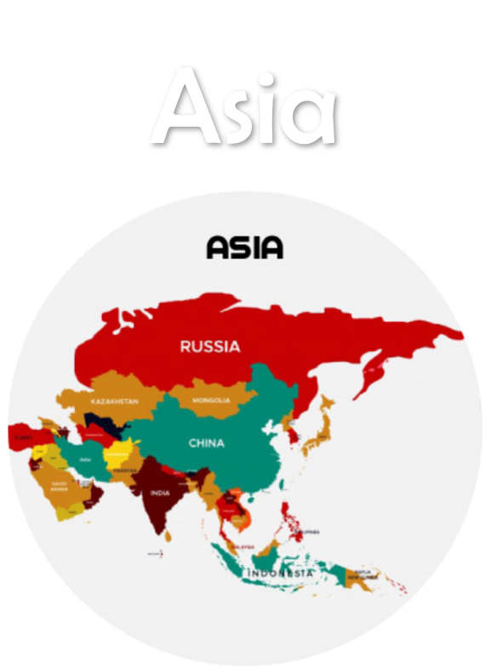
FREE
SHIPPING -
INTERNATIONAL
9 bottles
P55,000.00
P7,500/bot
Notes:
TOP RIGHT

Slide 107
DISCOUNT VOUCHER PRIVILEGE
P5,000.00
DISCOUNT VOUCHER
BUY ONE GET ONE
PER MONTH FOR ONE YEAR
ON SPECIAL PRODUCTS
@ MEMBERS PRICE
Notes:
NO CAM

Slide 108
ADDED BENEFIT
DIRECT REFERRAL
P5,000.00
TEAM SALES BONUS - BINARY
P8,000.00
TEAM SALES BONUS - TRINARY
P16,000.00
Notes:
TOP RIGHT

Slide 109

ADDED BENEFIT
YOU
PRESTIGE WILL PAIR WITH ALL ENTRY PACKAGES
Notes:
LOW RIGHT

Slide 110
ELEVATE
LEVEL UP

Slide 111


ELEVATE
LEVEL UP

Slide 112
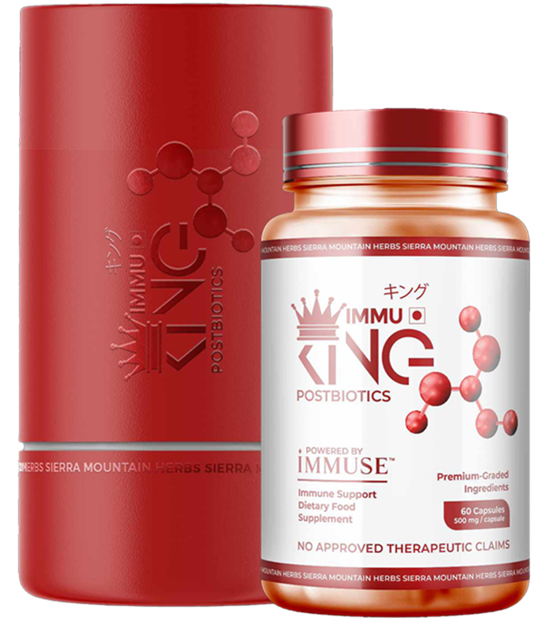
PACKAGE INCLUSIONS
Package 1
23 Bottles
of IMMUKING

Slide 113


PACKAGE INLUSIONS
Package 2
200 bots
KETO KLENZ
150 bots
MGVITMIN

Slide 114

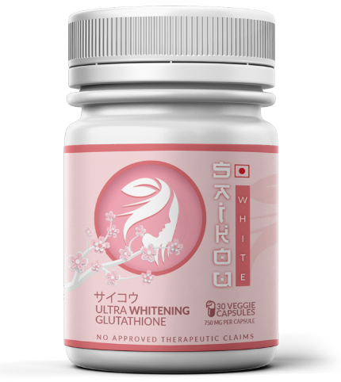
PACKAGE INLUSIONS
Package 3
60 bots:
ANY COMBINATION
OF SAIKOU WHITE & NITRIC BOOST

Slide 115
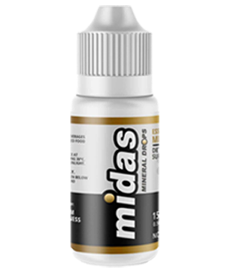
PACKAGE INLUSIONS
Package 4
7 bots IMMUKING
25 bots NITRICBOOST
OR SAIKOU WHITE
30 bots KETO KLENZ
30 bots MGVITMIN
30 bots MIDAS DROPS

Slide 116
FOR ONLY
P150,000.00

Slide 117
ADDITIONAL
BENEFITS

Slide 118
ADDITIONAL
BENEFITS
APPOINTED AS ONE PRODUCT HUB
ENJOY VIP PRICES ON ALL OTHER PRODUCTS.
GET P5,000 WORTH OF DISCOUNT VOUCHER PER MONTH FOR ONE YEAR
PROMOTED TO SUPERVISOR RANK

Slide 119
YOUR PRESTIGE
GOLD REWARDS

Slide 120

DIRECT REFERRAL
P10,000.00
TEAM SALES BONUS - BINARY
P15,200.00
TEAM SALES BONUS - TRINARY
P30,400.00

Slide 121
PRESTIGE GOLD
FAST TRACK BONUS

Slide 122

FOR STAR PROSELLER ACCOUNT HOLDER
P50,000.00
P10,000.00
P10,000.00
FAST TRACK BONUS
SPONSOR 2 PRESTIGE GOLD DISTRIBUTOR IN ONE MONTH
GET P50,000.00
PG FAST TRACK BONUS
P15,200.00
YOU NEED TO SPONSOR 4 WITHIN 6 MONTHS, IF YOU DON’T ACHIEVE IT IN THE FIRST MONTH TO GET THE
₱50,000 FTB

Slide 123

FOR PRESTIGE ACCOUNT HOLDER
P75,000.00
FAST TRACK BONUS
P10,000.00
P10,000.00
SPONSOR 2 PRESTIGE GOLD DISTRIBUTOR IN ONE MONTH
GET P75,000.00
PG FAST TRACK BONUS
P15,200.00
YOU NEED TO SPONSOR 4 WITHIN 6 MONTHS, IF YOU DON’T ACHIEVE IT IN THE FIRST MONTH TO GET THE
₱75,000 FTB

Slide 124
FOR PRESTIGE GOLD ACCOUNT HOLDER
P150,000.00
FAST TRACK BONUS
P10,000.00
P10,000.00
SPONSOR 2 PRESTIGE GOLD DISTRIBUTOR IN ONE MONTH
GET P150,000.00
PG FAST TRACK BONUS
P15,200.00
YOU NEED TO SPONSOR 4 WITHIN 6 MONTHS, IF YOU DON’T ACHIEVE IT IN THE FIRST MONTH TO GET THE
₱150,000 FTB

Slide 125
SMH REWARDS DISTRIBUTORS WHO PERFORM & CONTRIBUTE TO THE GROWTH OF THE COMPANY
Notes:
SMH rewards distributors who perform and contribute to the growth of the company

Slide 126
Introducing…
Where performance turns into profit
Notes:
SMH rewards distributors who perform and contribute to the growth of the company

Slide 127
RANK UP BONUS
Where performance turns into profit
SUPERVISOR
GLOBAL PROSELLER
MANAGER
EXEC. MANAGER
HALL OF FAMER
DIRECTOR
EXEC. DIRECTOR

Slide 128
RANK UP BONUS
Where performance turns into profit
SUPERVISOR
* Rank Up Bonus — ₱12,000.00 & now boosted to ₱25,000.00 for a limited time only
* 75 pairs (packages)
* 25 pairs (repeat purchase)
MANAGER
* Rank Up Bonus — ₱25,000.00 & now boosted to ₱50,000.00 for a limited time only
* 150 pairs (packages)
* 50 pairs (repeat purchase)
Notes:
SUPERVISOR = P40,000.00

Slide 129
RANK UP BONUS
Where performance turns into profit
EXEC. MANAGER
* Rank Up Bonus — ₱50,000.00 & now boosted to ₱100,000.00 for a limited time only
* 300 pairs (packages)
* 100 pairs (repeat purchase)
DIRECTOR
* Rank Up Bonus — ₱100,000.00 now boosted to ₱200,000.00 for a limited time only
* 600 pairs (packages)
* 100 pairs (repeat purchase)

Slide 130
RANK UP BONUS
Where performance turns into profit
EXEC. DIRECTOR
* Rank Up Bonus — ₱200,000.00 now boosted to ₱400,000.00 for a limited time only
* 1,200 pairs (packages)
* 200 pairs (repeat purchase)
GLOBAL PROSELLER
* Rank Up Bonus — ₱500,000.00 now boosted to ₱1,000,000.00 for a limited time only
* 2,400 pairs (packages)
* 400 pairs (repeat purchase)

Slide 131
RANK UP BONUS
Where performance turns into profit
HALL OF FAMER
* 4,800 pairs (packages)
* 800 pairs (repeat purchase)
Rank Up Bonus — ₱1,000,000.00
now boosted to ₱2,000,000.00 for a limited time only

